Slide 1
Commtap Free web based resource for working with children and adults with communication difficulties www.commtap.org

Slide 2
Quick tour!

Slide 3
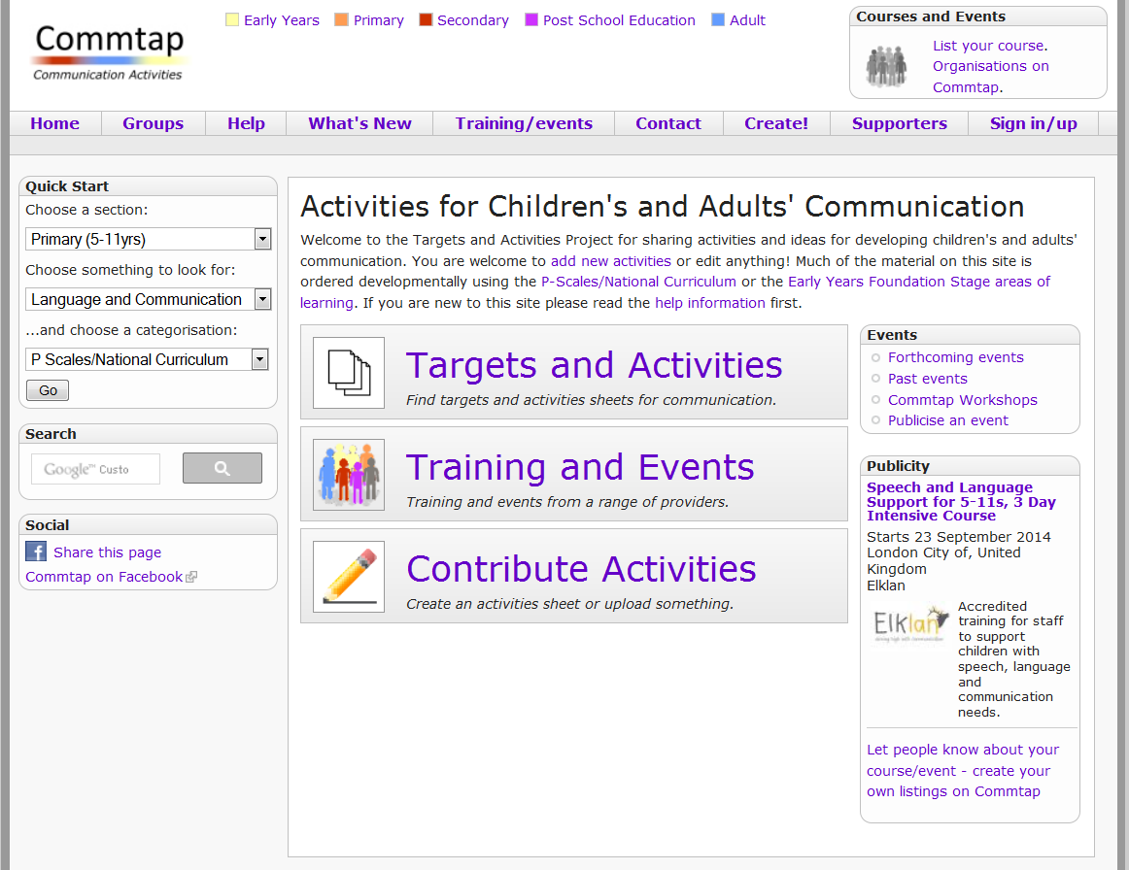

Slide 4
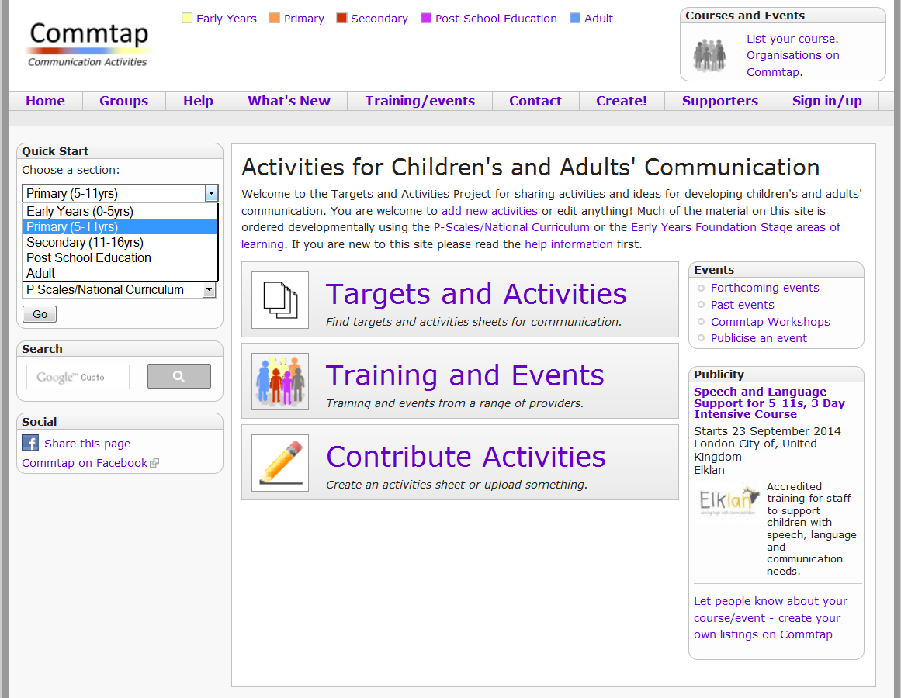

Slide 5
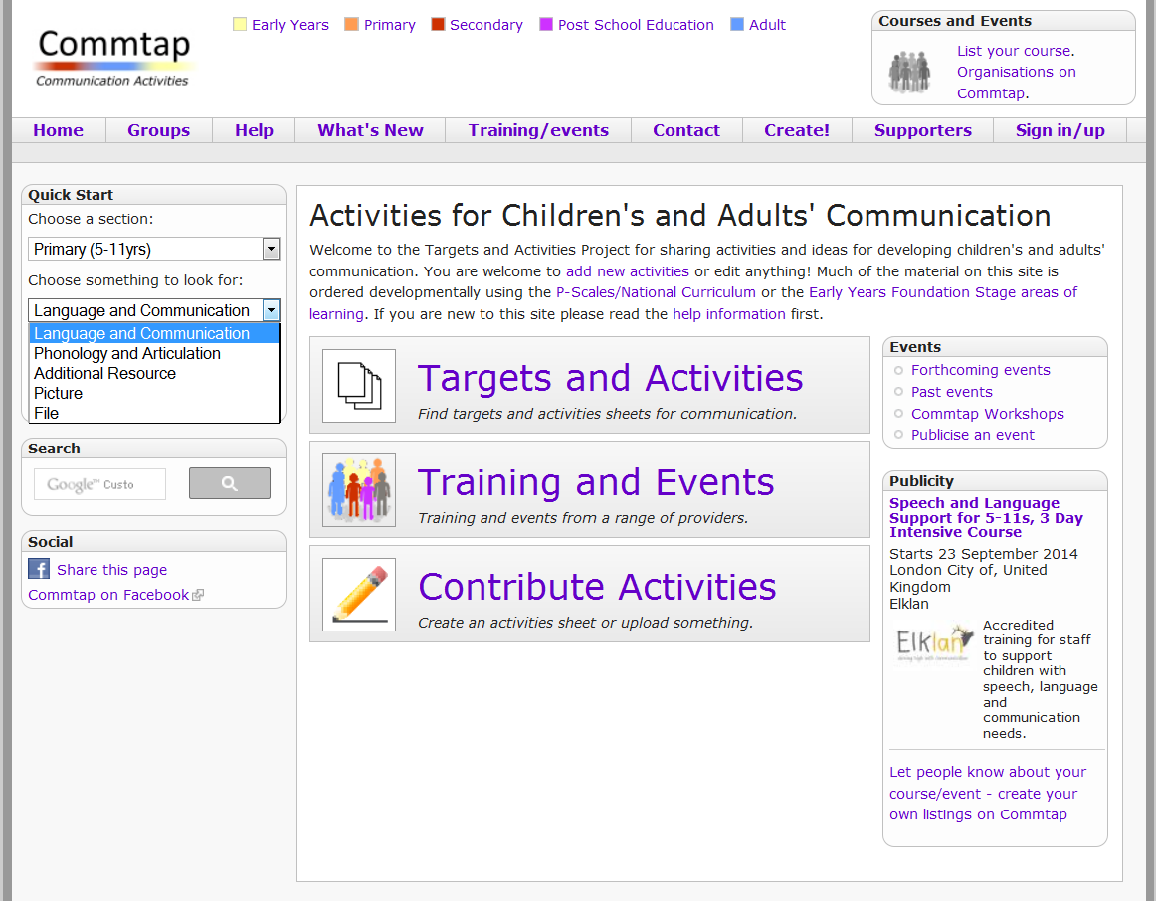

Slide 6
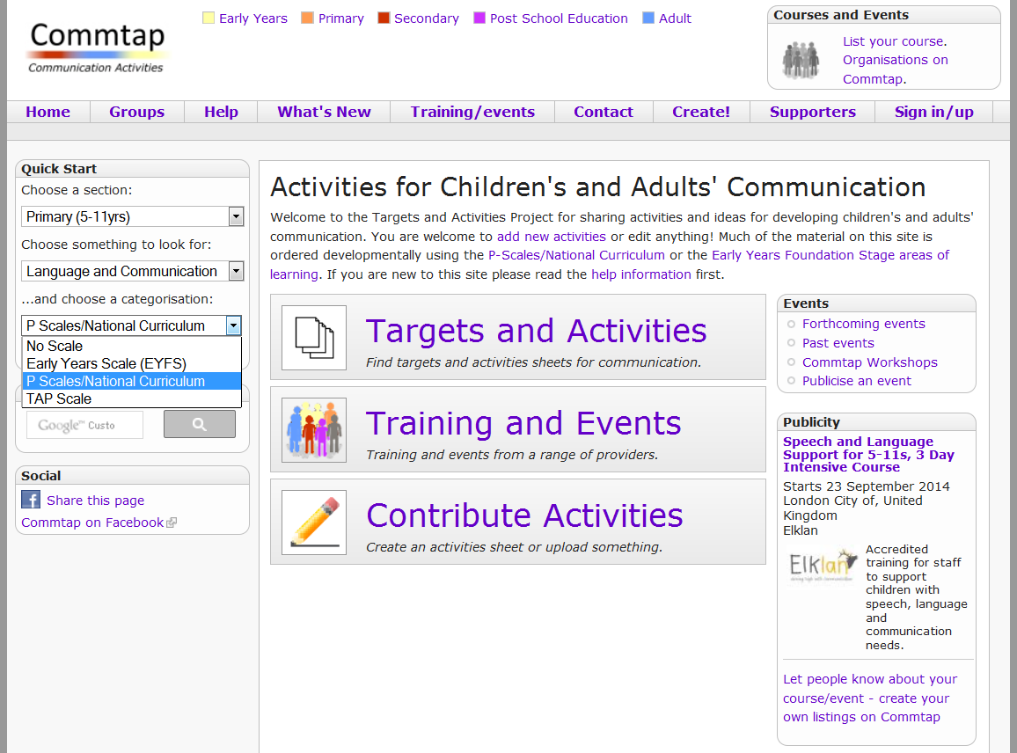

Slide 8
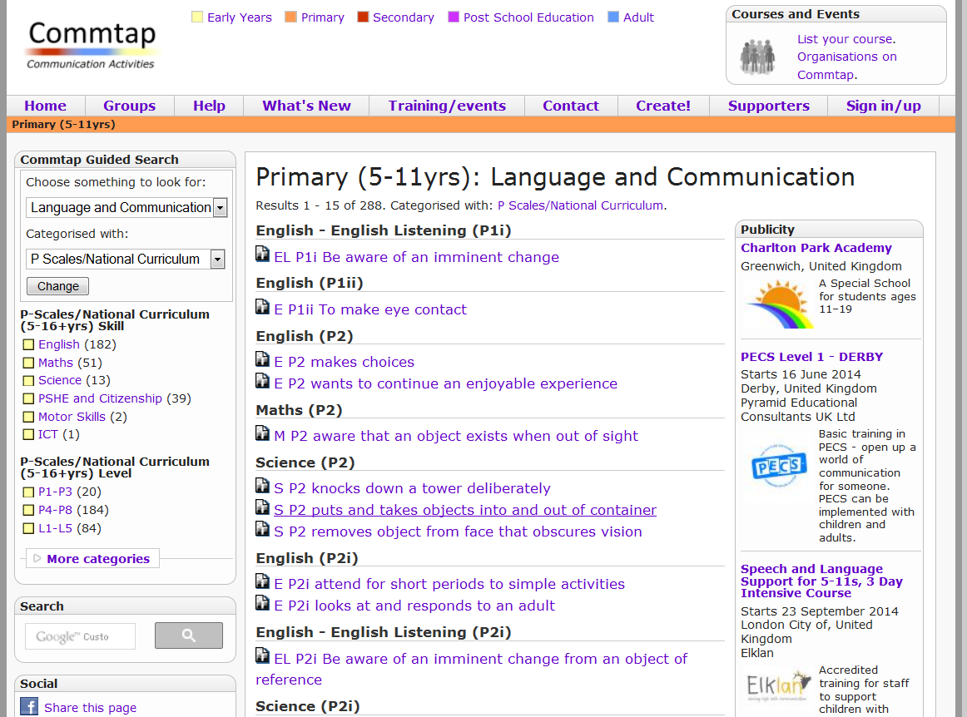

Slide 9
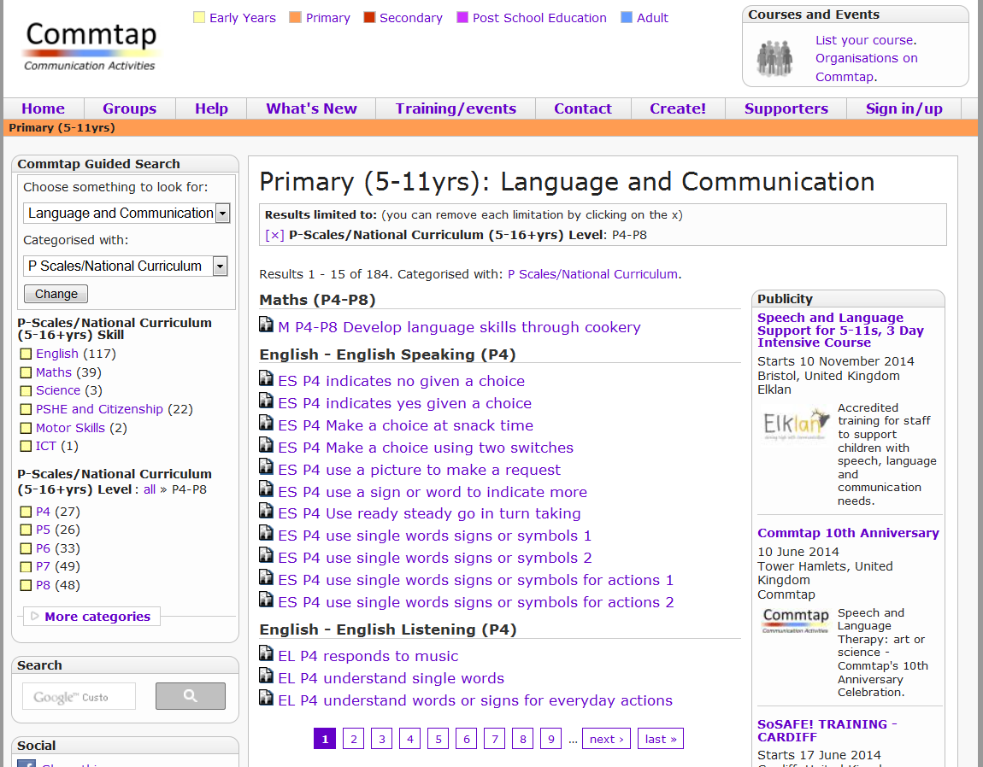

Slide 10
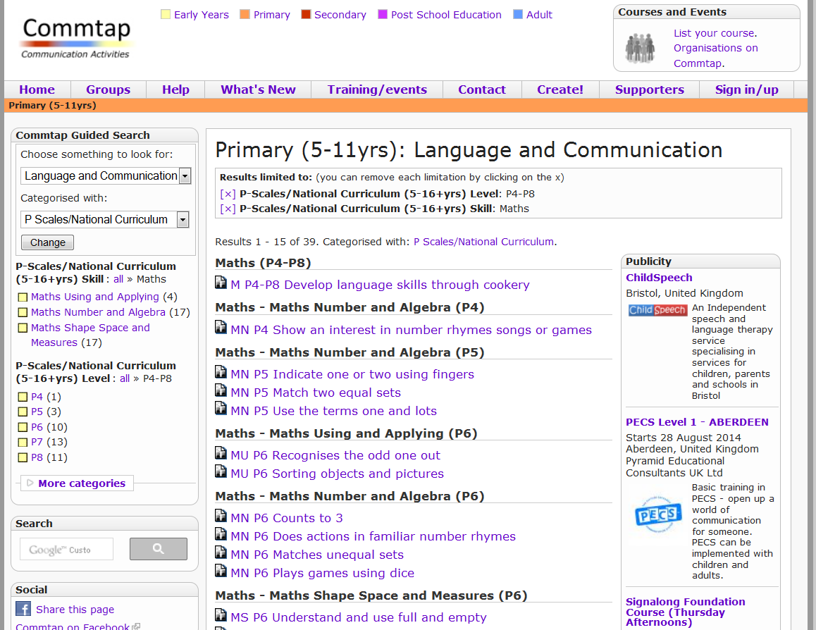

Slide 11
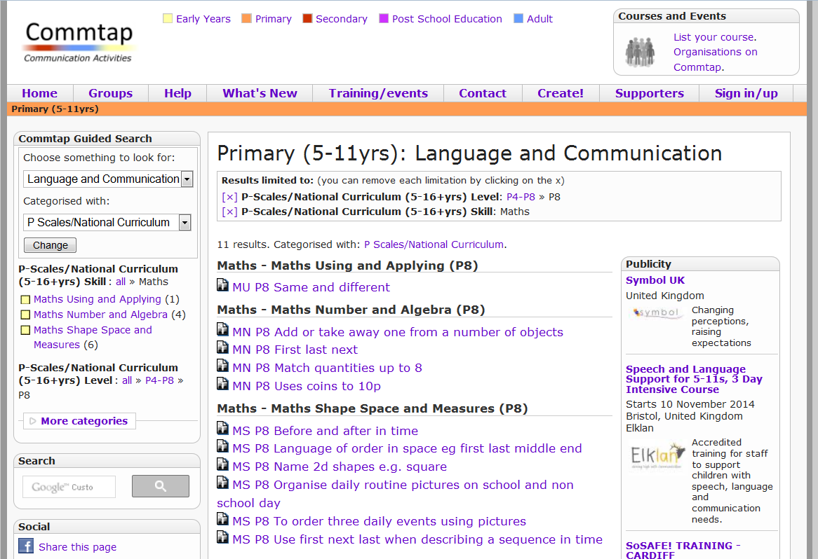

Slide 12
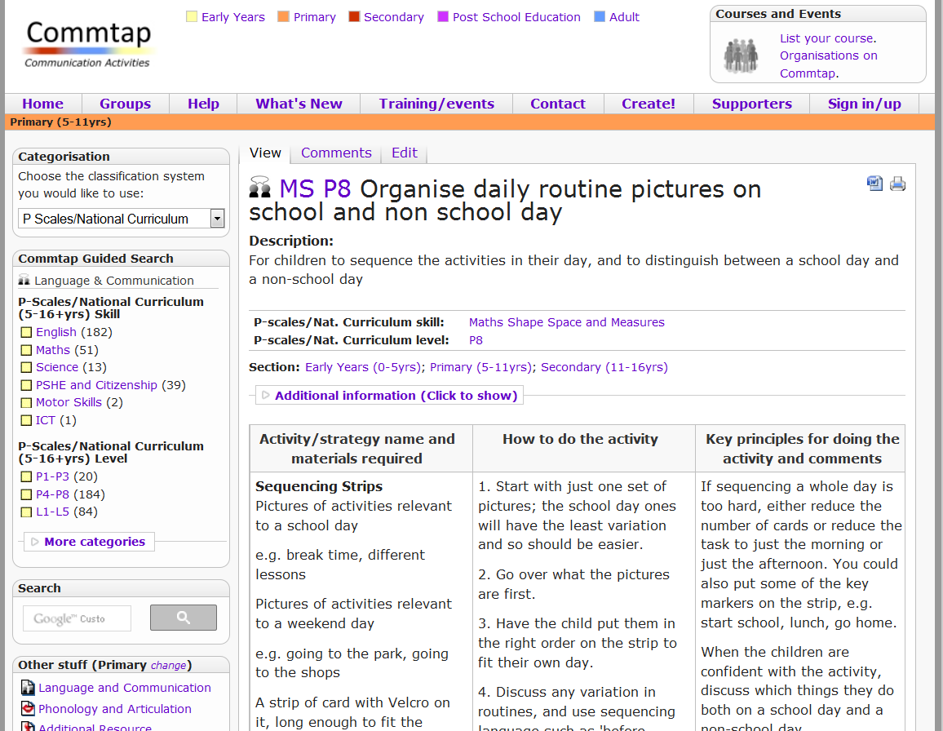

Slide 13
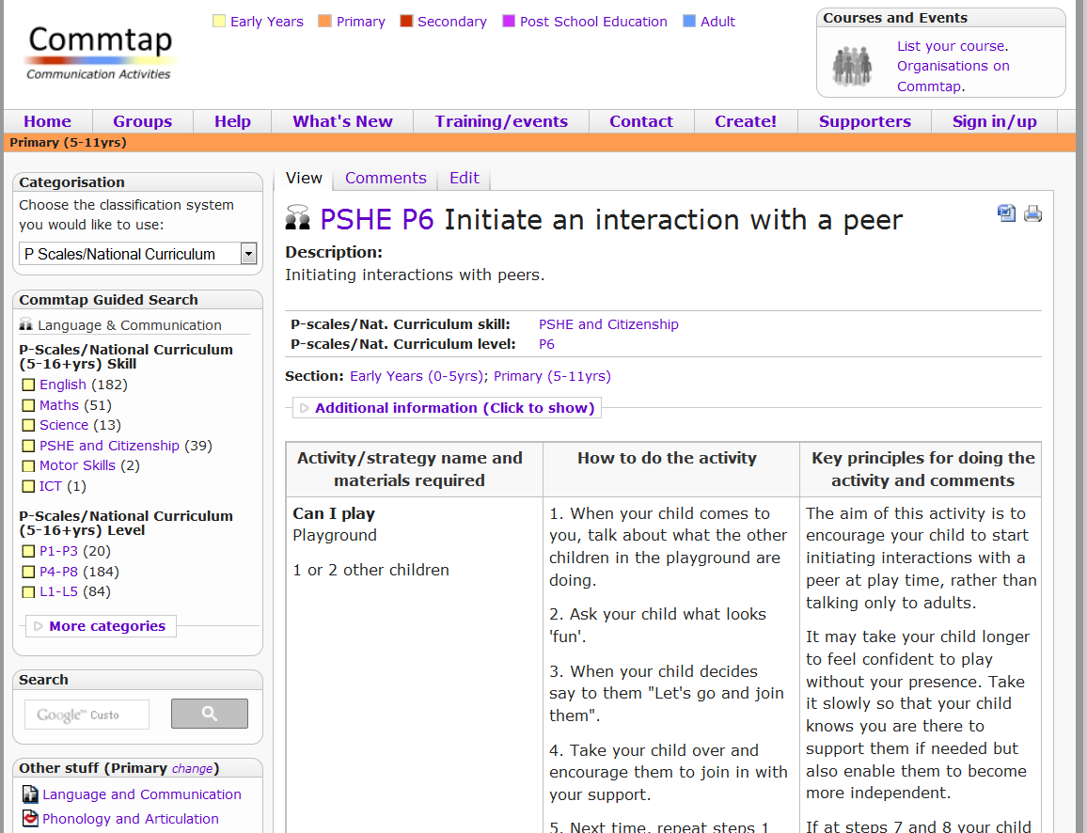

Slide 14
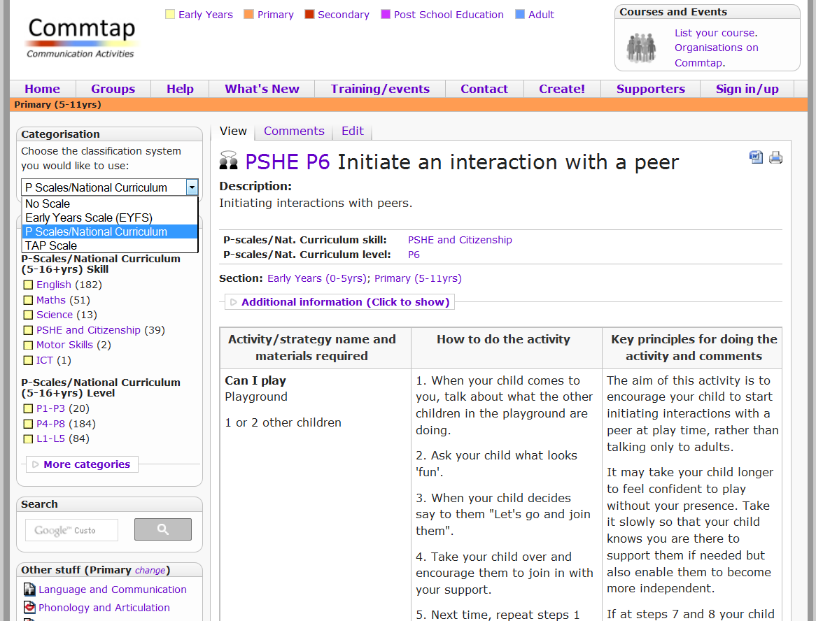

Slide 15
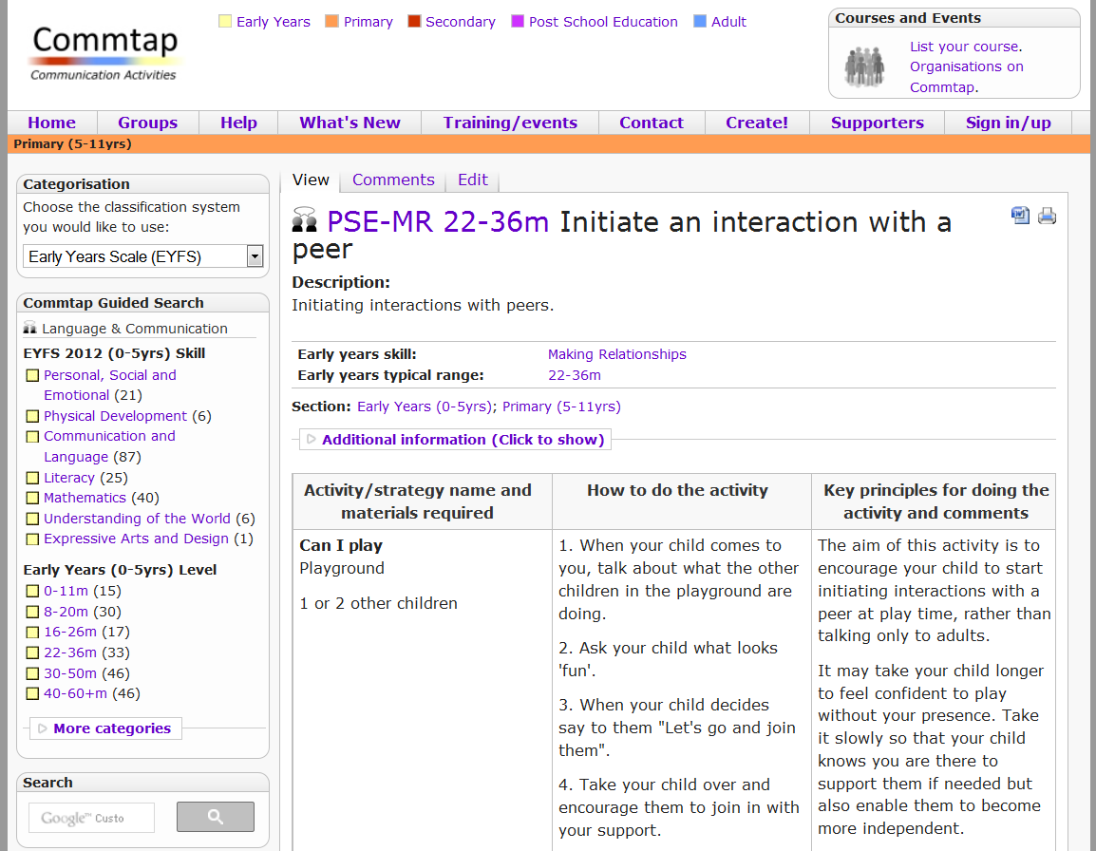

Slide 16
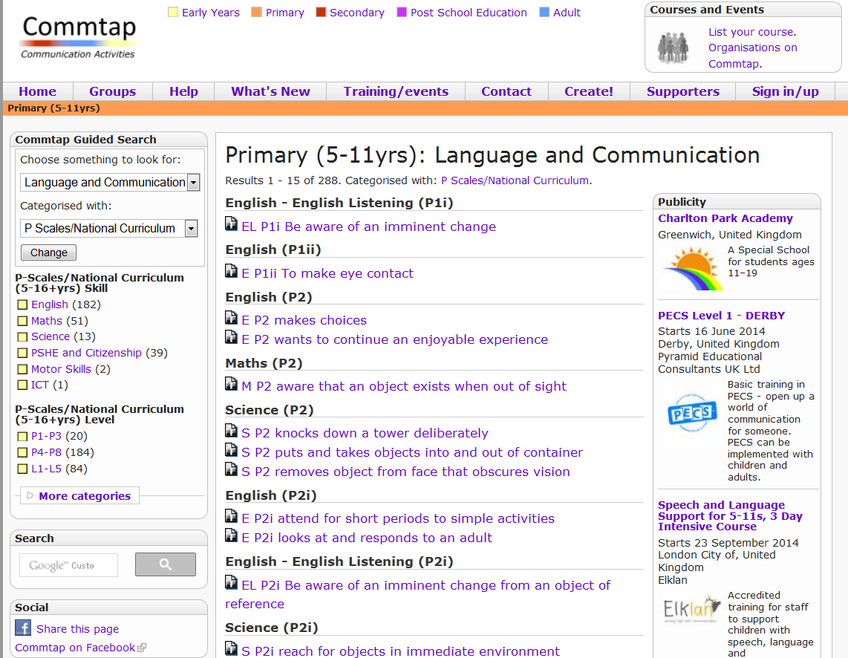

Slide 17
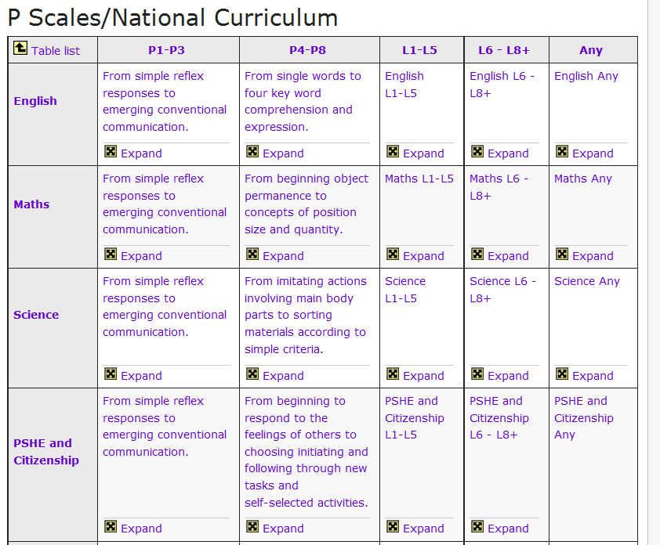

Slide 18
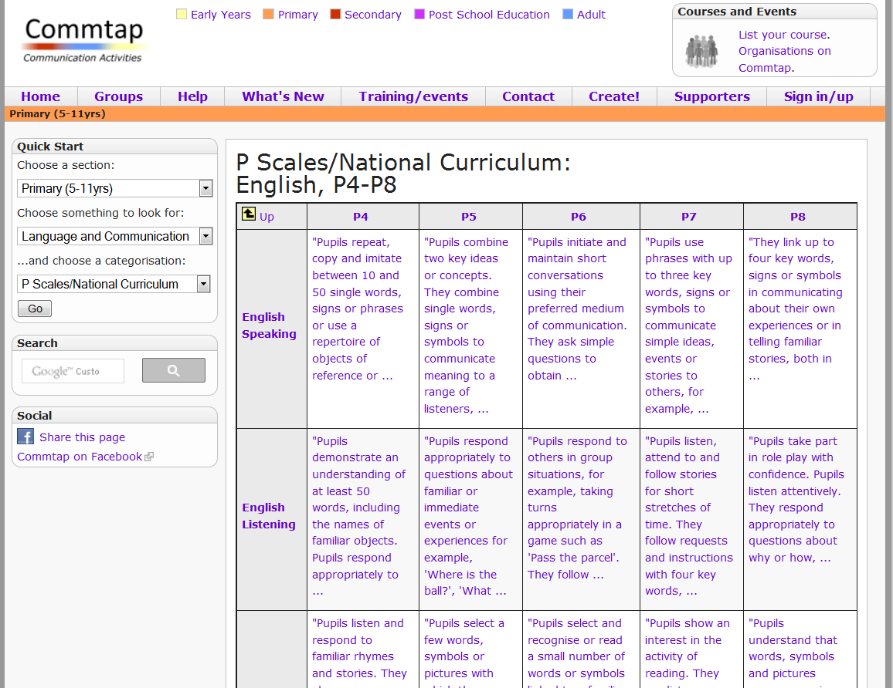

Slide 19
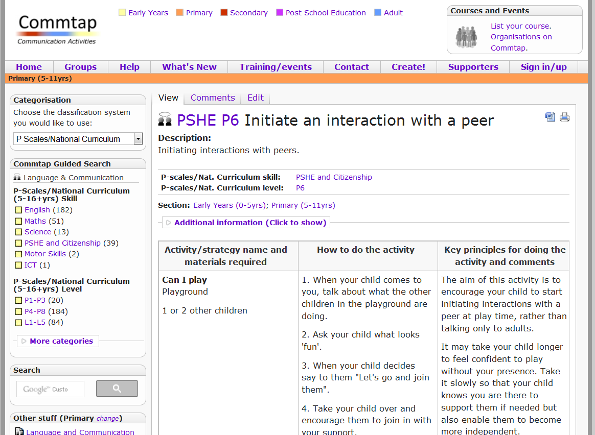

Slide 21
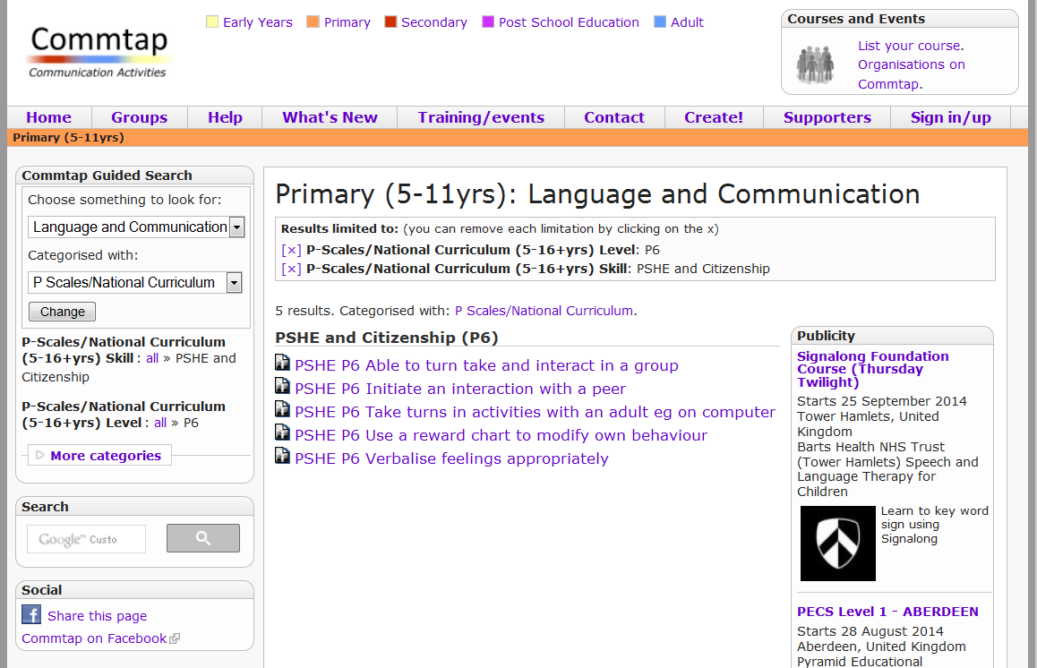

Slide 23
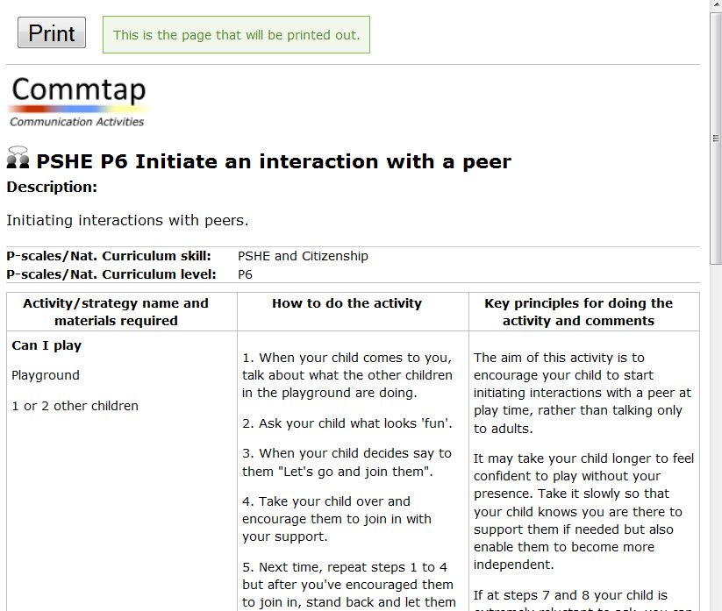

Slide 24
Finding Activities on the Site
1. Go to the site – www.commtap.org. Go to the primary or secondary section.
2. Find some activities for talking about past events. What levels are they?
3. Find something in Maths Number level P5;
4. Find something at PHSE (Personal, Social and Health Education) L1.
5. Find the P Scales/National Curriculum descriptions table.

Slide 25
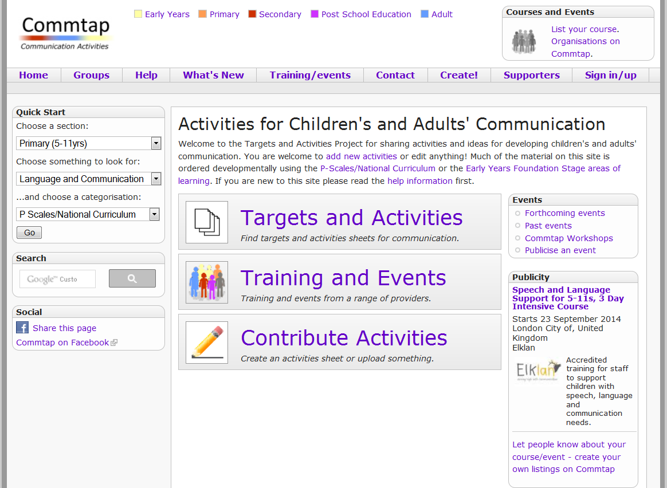

Slide 26
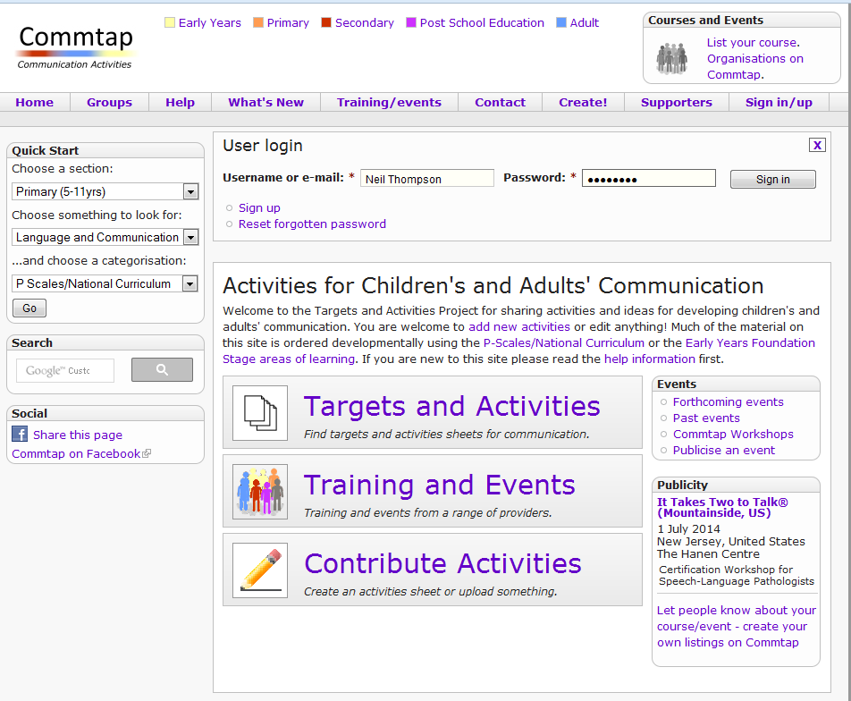

Slide 27
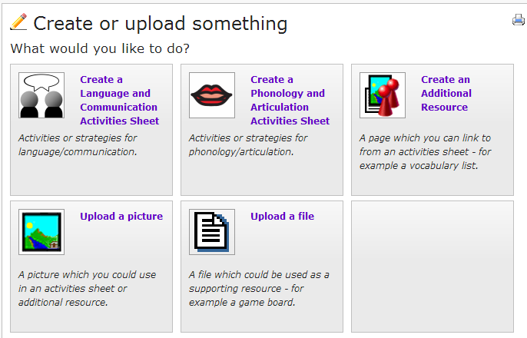

Slide 28
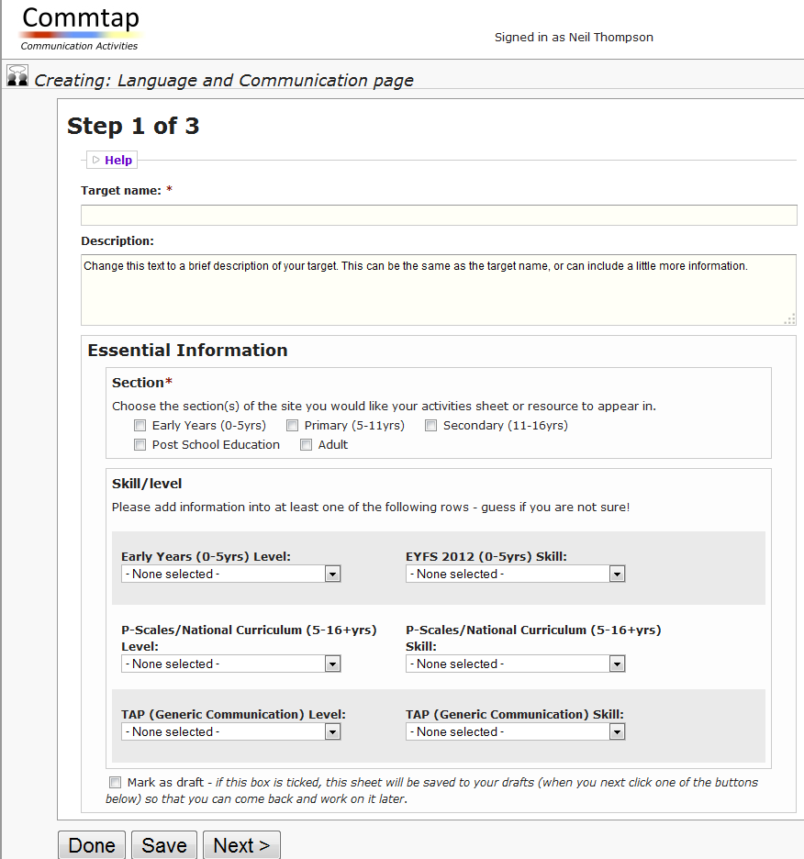

Slide 29
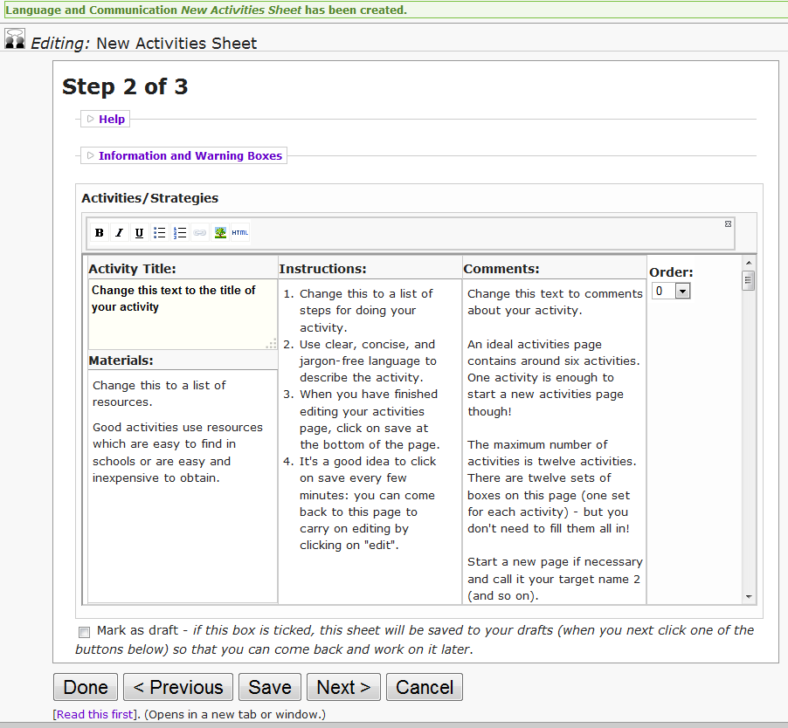

Slide 30
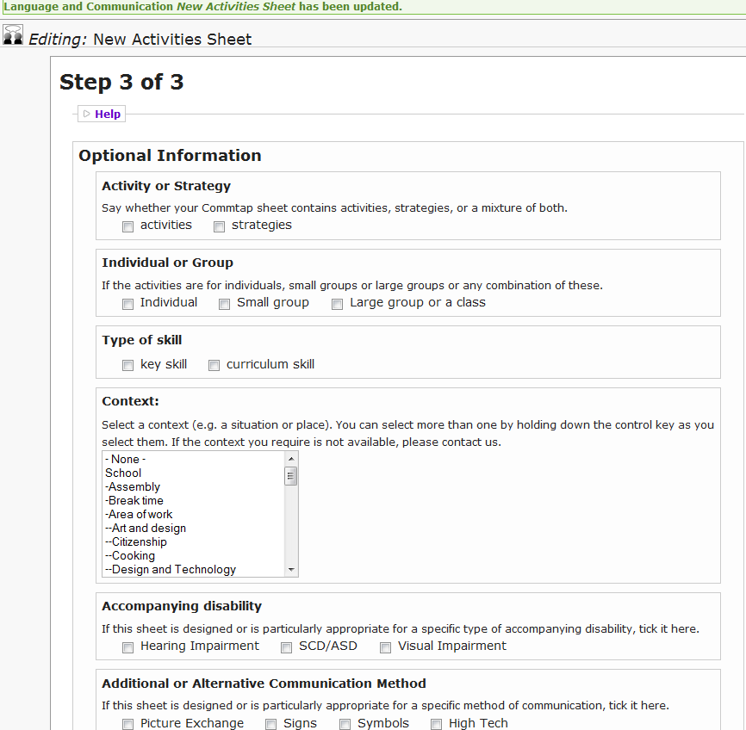

Slide 31
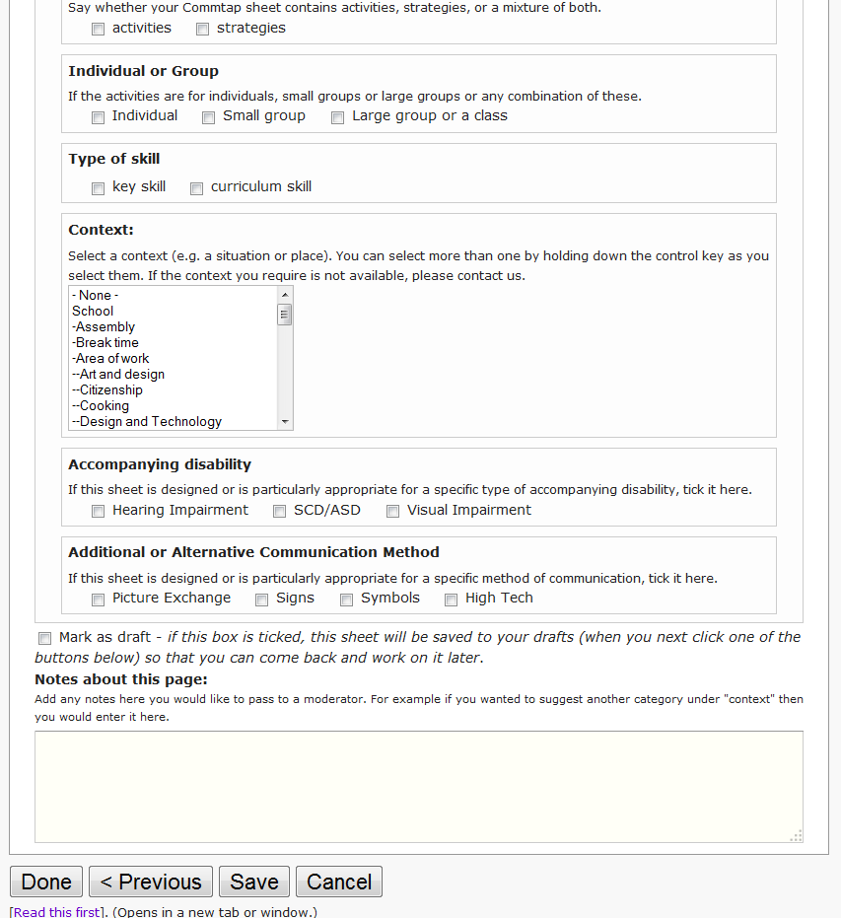

Slide 32
Creating Activities: Coming Very Soon
Create your own set of activities on Commtap
Choose whether or not you want to share them on the site
Choose to share them as yourself or anonymously

Slide 36
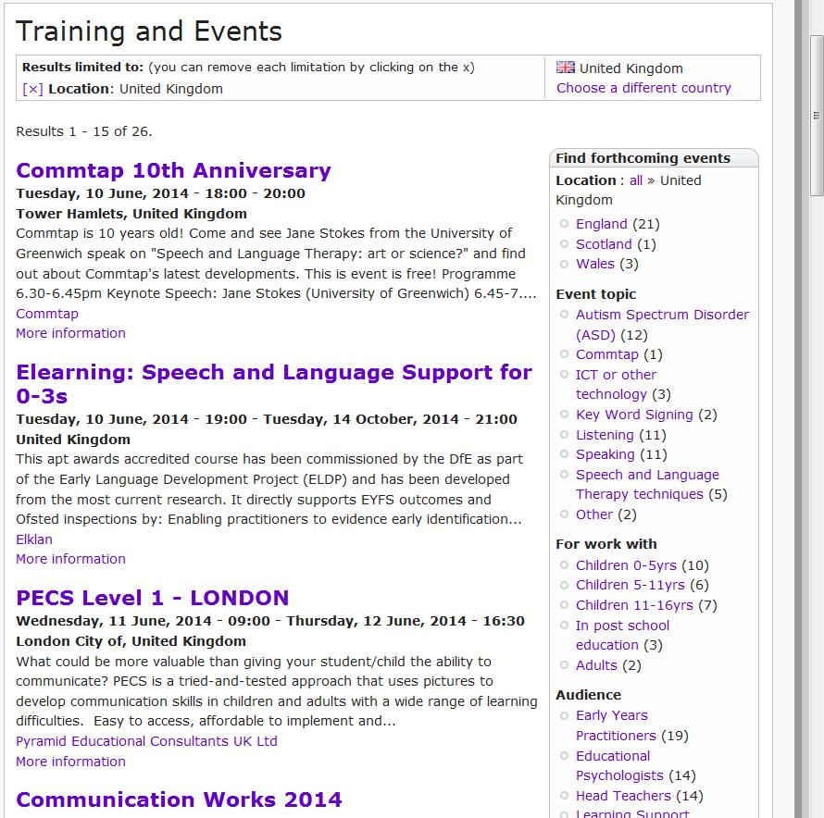

Slide 37
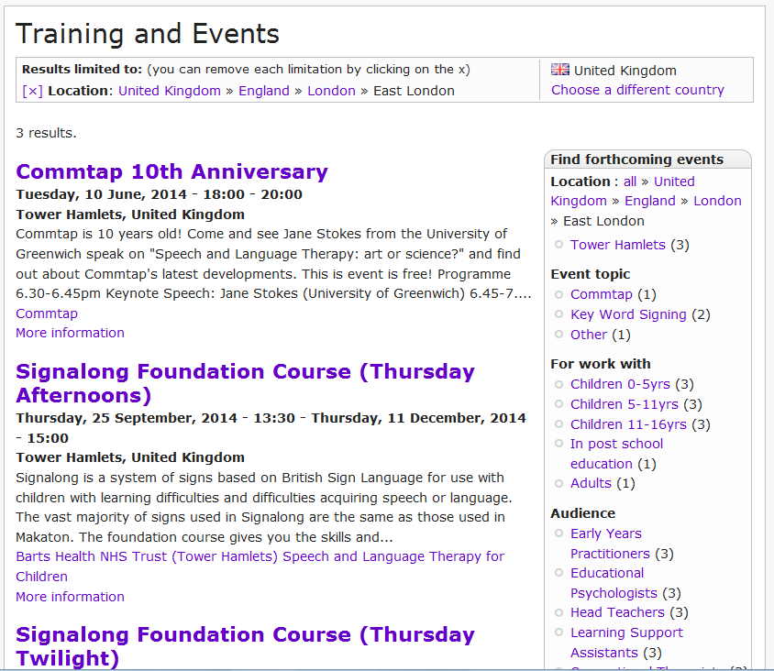

Slide 38
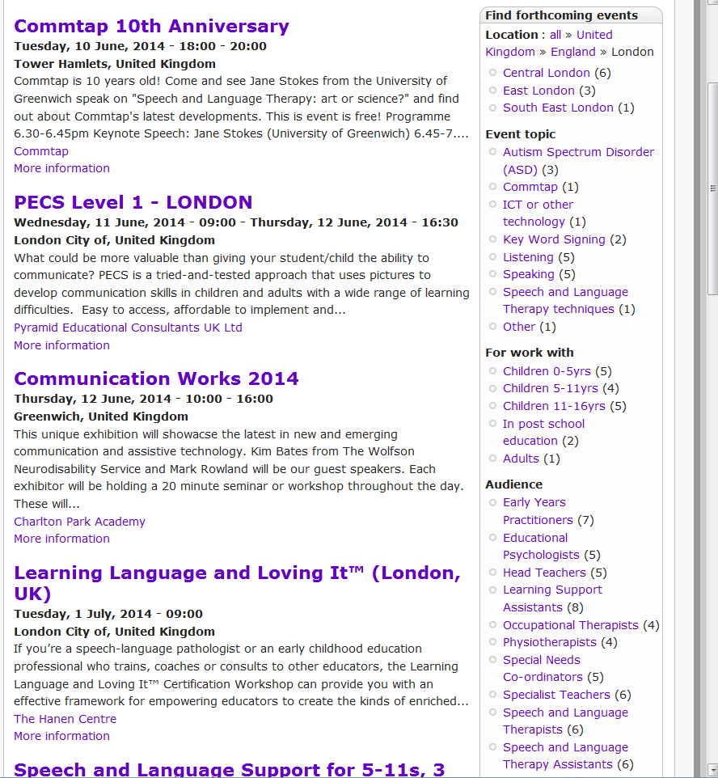

Slide 39
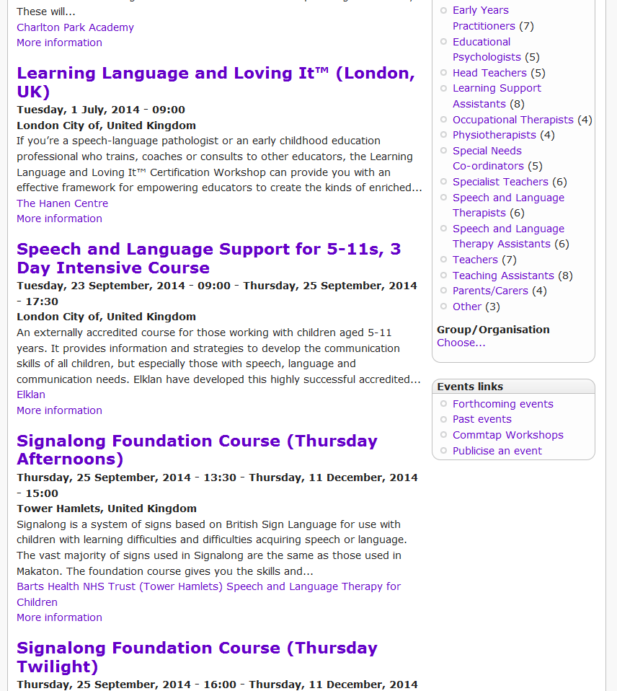

Slide 40
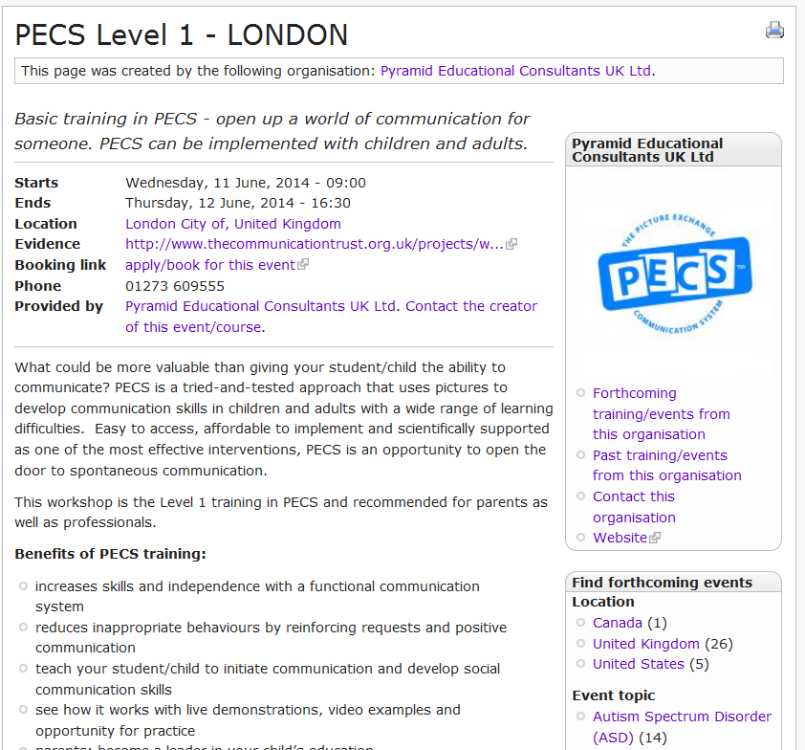

Slide 42
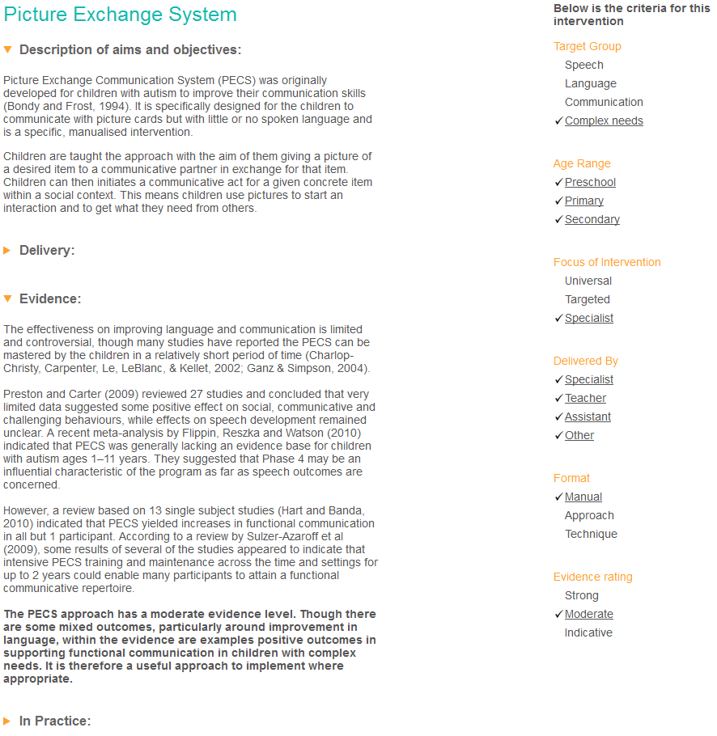

Slide 45
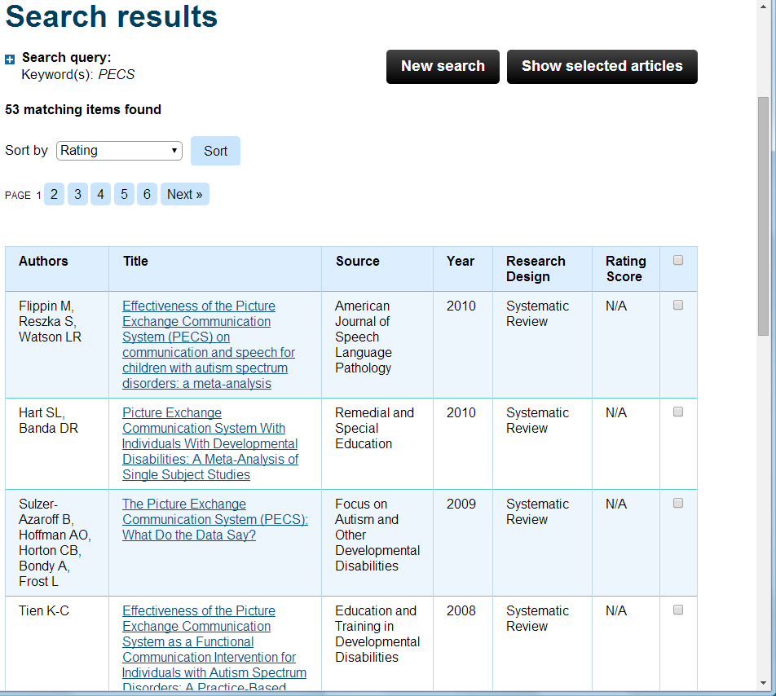

Slide 46
Databases of Evidence
What Works
www.thecommunicationtrust.org.uk
speechBITE
speechbite.com

Slide 47
Criteria for showing training for intervention techniques on Commtap
Techniques should conform to the criteria set out for inclusion in the What Works database for interventions for children (and similarly for adults);
There should be detailed information about who the technique helps: any claims to the success of a technique should clearly state the profile of the people that these claims apply to;
For those that an intervention may not help, the fact of having gone through a particular intervention should not result in the loss or significant reduction of effectiveness of another communication option - for example if this alternative option is started when a child has passed the age for optimal learning of such an option;

Slide 48
Criteria for showing training for intervention techniques on Commtap
In general, intervention techniques should be inclusive - rather than exclusive - of other communication methods (including speech, sign, picture symbols, aided communication);
Information about what methods an intervention technique includes should be freely available: it should not be a "secret recipe" as this makes it difficult for people to know what is really being offered;
Intervention techniques should be realistic in terms of the amount of time and money required: methods which require a significant amount of time - particularly from a specialist - and/or significant amounts of money should be avoided;

Slide 49
Criteria for showing training for intervention techniques on Commtap
Ideally, research evidence should come from independent research rather than from those who initially developed it;
Claims for an intervention technique should be realistic about what can be achieved, including not setting up false expectations amongst clients/carers about what an intervention can achieve for them;
A description of an intervention technique should not imply that Commtap in any way endorses the technique.

Slide 50
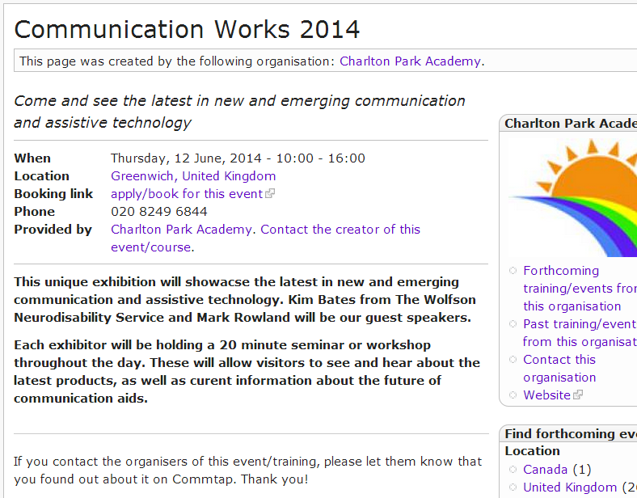

Slide 51
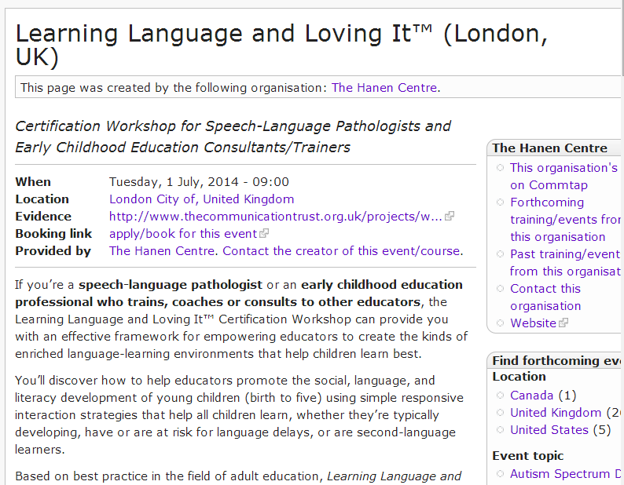

Slide 52
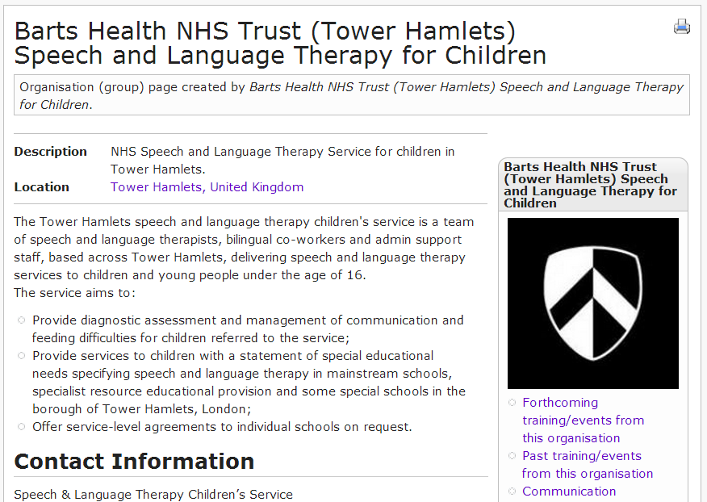

Slide 53
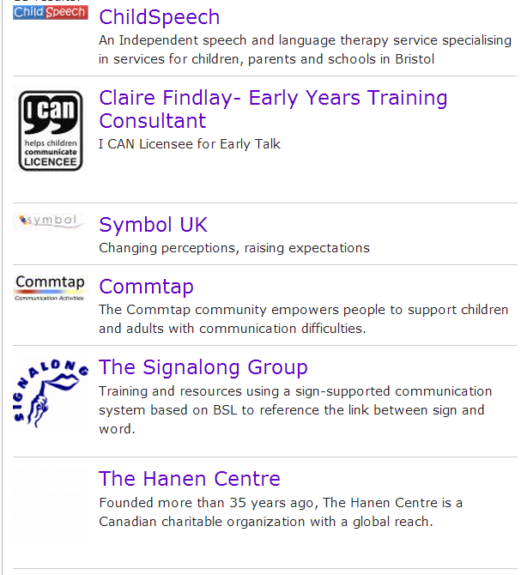

Slide 54
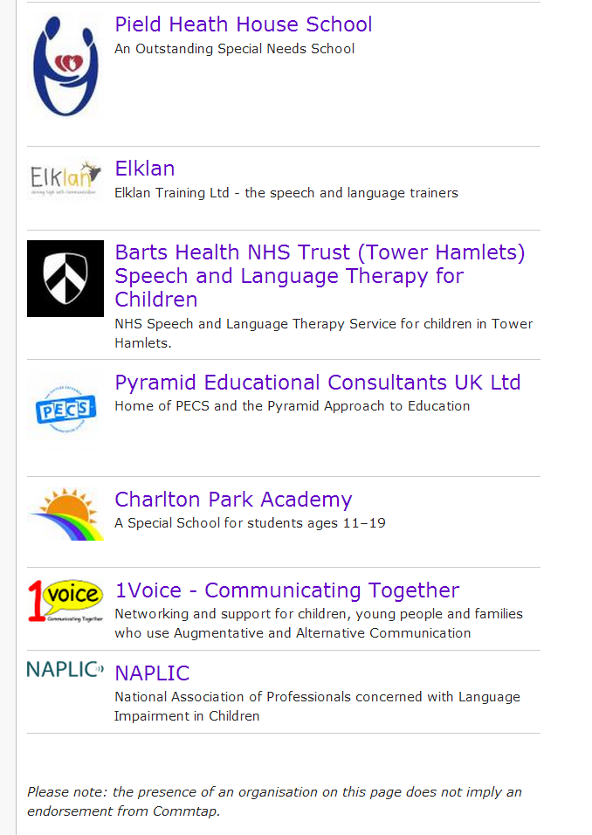

Slide 55
Finding Events
Find some training and events in London.
Find the application for an organisation page on Commtap.
Find this event!

Slide 56
Questions

