Slide 1


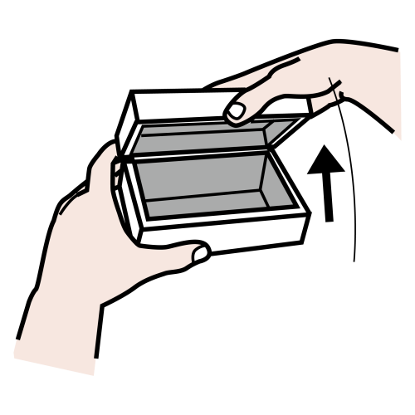
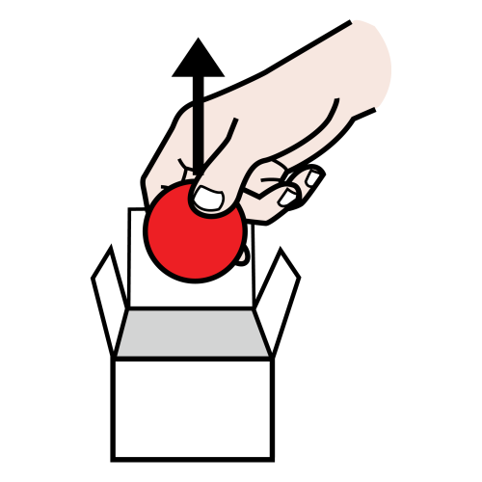

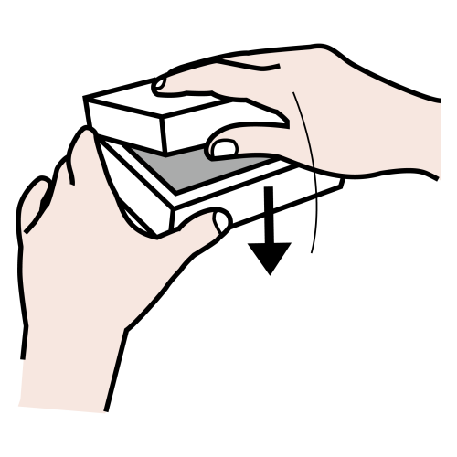
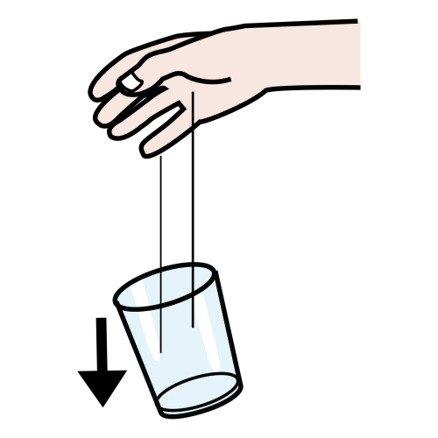
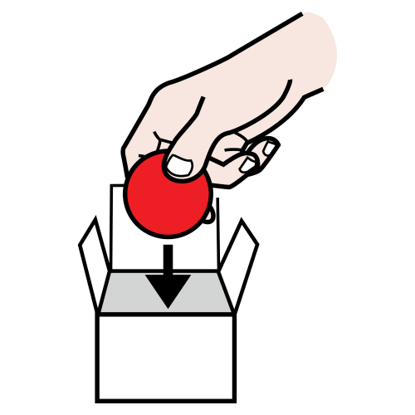




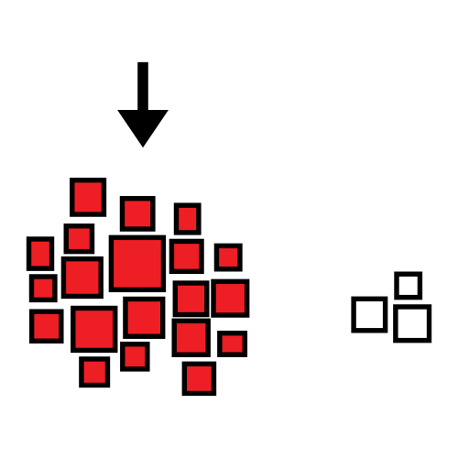
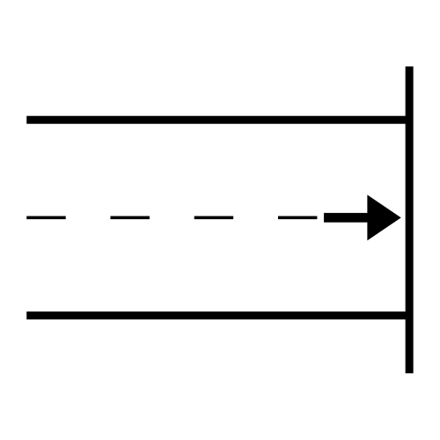
bubbles
blow
open
take out
wow!
!
close
put in
oh no!
dropped
my go
your go
gone
more
finish
Created using the Commtap Symboliser for PowerPoint (symboliser.commtap.org) and Arasaac Symbols (arasaac.org). Arasaac symbols are free (“Creative Commons”) and can be downloaded from commtap.org.

Slide 2




tower of bricks
knock it over
another
block
higher
wow!
!
high
oh no!
my go
your go
again
finish
Created using the Commtap Symboliser for PowerPoint (symboliser.commtap.org), Arasaac (arasaac.org) and Mulberry symbols. These symbol sets are free “Creative Commons” and can be downloaded from commtap.org.

Slide 3





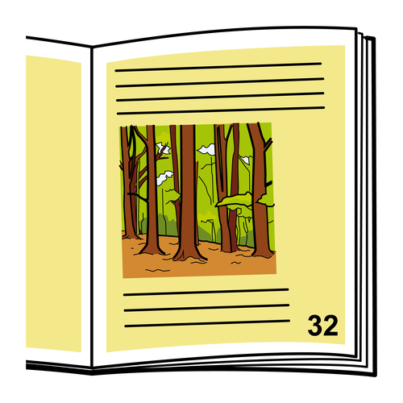



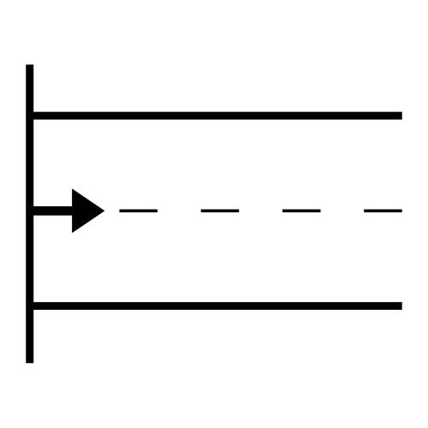
read a book
what’s that?
why?
next
page
look
wow!
!
happy
that’s funny
oh no!
sad
I
you
beginning
again
end
Created using the Commtap Symboliser for PowerPoint (symboliser.commtap.org) and Arasaac Symbols (arasaac.org). Arasaac symbols are free (“Creative Commons”) and can be downloaded from commtap.org. “What’s that?” and “Why?” questions are for the child to use – not you (except for the occasional modelling).

