Slide 1
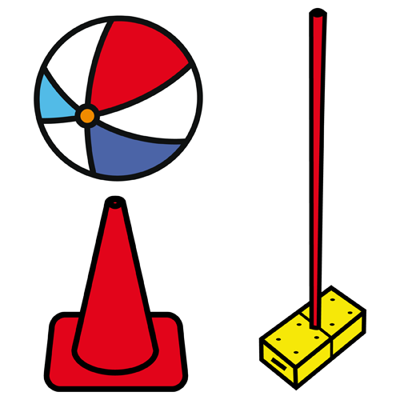
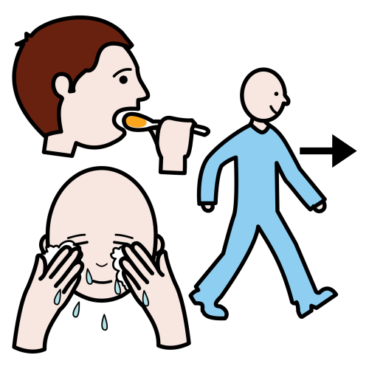

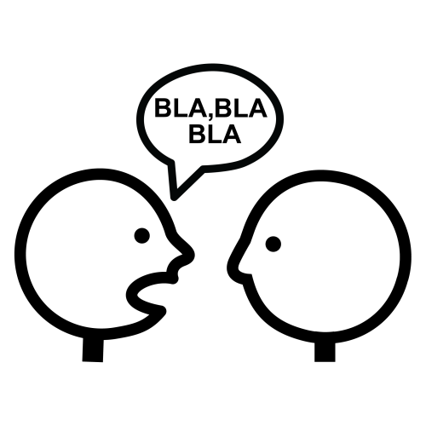

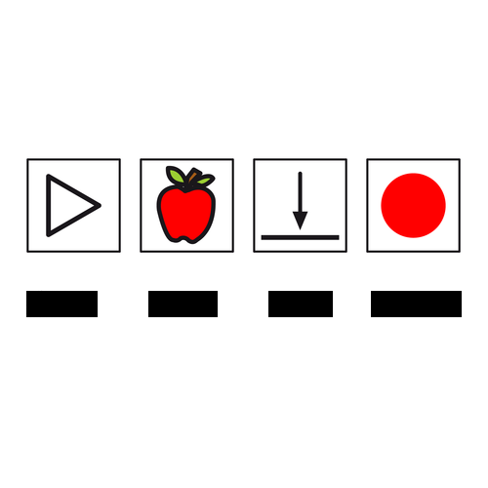
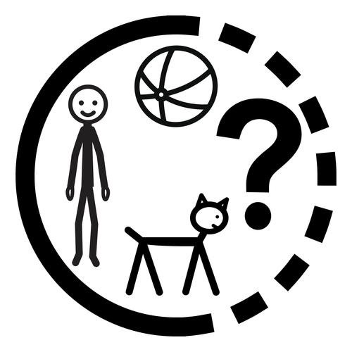




TEMPLATE
Part of speech:
Describe it:
Similar meaning:
Category:
In a sentence:
word
Other information:
To do with who/what?:
Opposite:

Slide 2
EXAMPLE
Part of speech:
Describe it:
Similar meaning:
An action which is done to deliberately obstruct or disrupt something.
verb
disrupt
damage
interfere
Category:
sabotage
In a sentence:
The factory closed because someone had sabotaged the machines.
Other information:
To do with who/what?:
Opposite:
Often used when someone means to cause serious harm or damage.
People and/or things: for example “the weather sabotaged our plans”, “Jim sabotaged (ruined) our picnic.”
Assist, help.

Slide 3
EXPLANATION
Part of speech:
Describe it:
Similar meaning:
Brief description, definition.
For example, noun (thing), verb (action), adjective (describing word).
Words having similar meanings, synonyms.
Category:
In a sentence:
write the word here
Give an example or two using the word in a sentence.
Does it relate to a particular topic? Is it a type of a thing (e.g. animal, cutlery). There could be more than one category.
Other information:
To do with who/what?:
Opposite:
Anything else you can think of about the word.
For example does it apply to people, animals, things, specific things, specific animals, or can it be applied more generally.
Words which have an opposite or opposing meaning.
Notes:
All the picture symbols used in these slides are either Arasaac symbols (arasaac.org) or Mulberry symbols (mulberrysymbols.org). Arasaac symbols are free to use and modify for non-commercial use. Mulberry symbols may be used and modified for either commercial or non-commercial use. You can see which symbols are which by: on the Home ribbon, go to Editing – Select – Selection pane. Image labels either start with List:arasaac- or List:mulberry-
You can download these symbol sets from: https://symboliser.commtap.org/online-symbols-sets/

