Slide 1

Using Commtap
Communication Targets and Activities Project

Slide 2
Summary
Typical Speech and Language Therapy process
Purpose of Commtap
How the Commtap site is organised
Commtap philosophy
Adding stuff to the site
Summary
Notes:
Use it or loose it
It’s as good as you make it
Growth through collaboration

Slide 3
Typical specialist input for communication
Do some assessment
Carry out some kind of intervention
Train others to carry out this intervention
Provide or recommend activities for others to continue with
Try to integrate this work into what else is happening for the children

Slide 4
Typical targeted input for communication
Identified group of children
Carry out some kind of work to develop communication
Train others to carry out this work
Provide or recommend activities for others to continue with

Slide 5
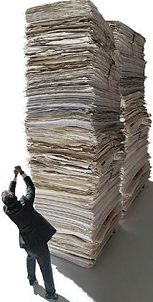

Problems
Providing programmes and ideas
  Can be either too much:
Or too little…
Notes:
Schools often have no way of regulating the amount of stuff they get
A successful school run language group requires (amongst other things) an adequate supply of easy to use activities
Therapists may not visit schools very often, and may compensate by providing a lot of stuff all at once

Slide 6
Problems…
Variety of formats
Not clearly linked to what else is going on for the child
Lots of rewriting of the same old stuff or…
Use of whatever was in the filing cabinet which seemed vaguely appropriate – hopefully now supplemented with lot better resources from the internet or your computer

Slide 7
The idea behind Commtap
Avoid duplication of effort
Have activities based on actual communication targets or goals
Have them organised logically so they can easily be found
Use education as well as speech and language therapy language
Easy access for all

Slide 8
The Commtap website
Designed to be simple, quick and easy to use
Easy for people to add to it
Creates a community to share activities:
  For people to use the site to support advice from specialists
  For SLTs and others to be actively involved in developing the activities on the site
All activities and resources added to the site are checked/edited before being made publicly viewable

Slide 9
How stuff is organised
To organise activities and other resources on the site, Commtap uses:
The Early Years Foundation Stage Curriculum
The P-Scales
The National Curriculum
A “TAP” (Targets and Activities Project) Scale (for good luck!)

Slide 10
Fitting stuff into the scales
Just about any language or social skills target can be fitted into these scales
To get these levels right, we use:
The Department for Education’s descriptions of these scales;
Published assessment tools – particularly B-Squared;
Published research.
Notes:
B-Squared gives more detailed information about what might be expected at each level.

Slide 11
Phonology and Articulation
Speech phonology and articulation does not fit well into these scales
Targets and activities for this area are organised around different types of speech skills

Slide 12
The Commtap Site
Finding activities sheets
Core philosophy
Contributing to the site
Quality control

Slide 13
Finding activities sheets

Slide 14
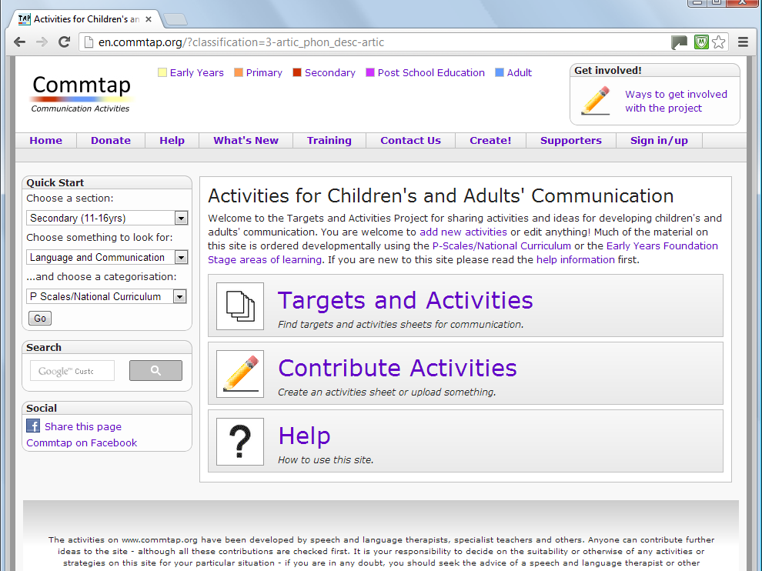
Notes:
You can find activities sheets in various ways. We’ll choose “Targets and Activities” as this will show you more how the site is structured.

Slide 15
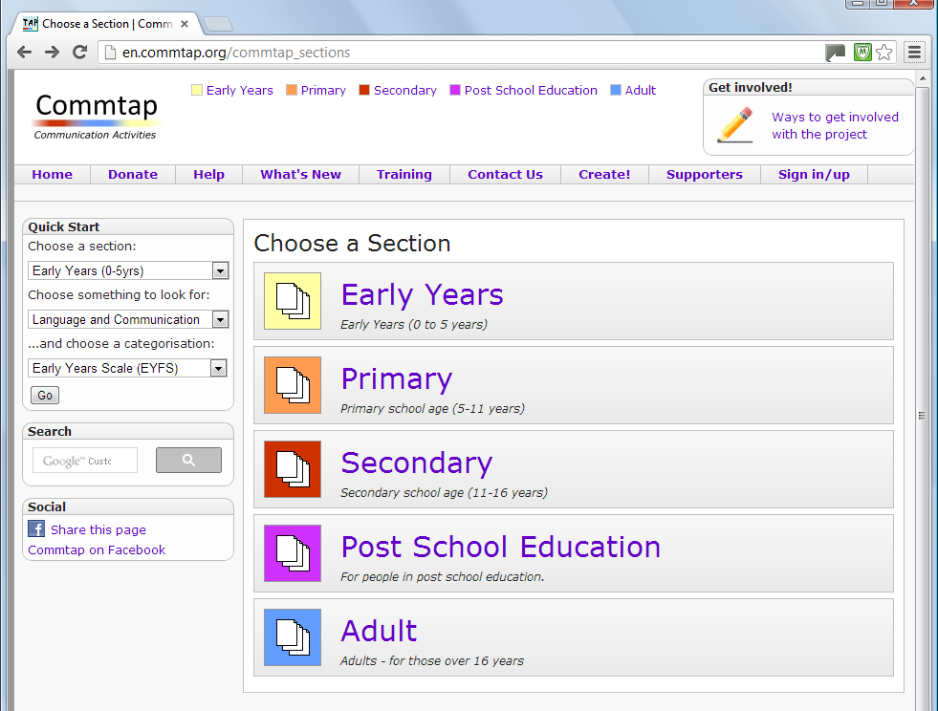

Slide 16
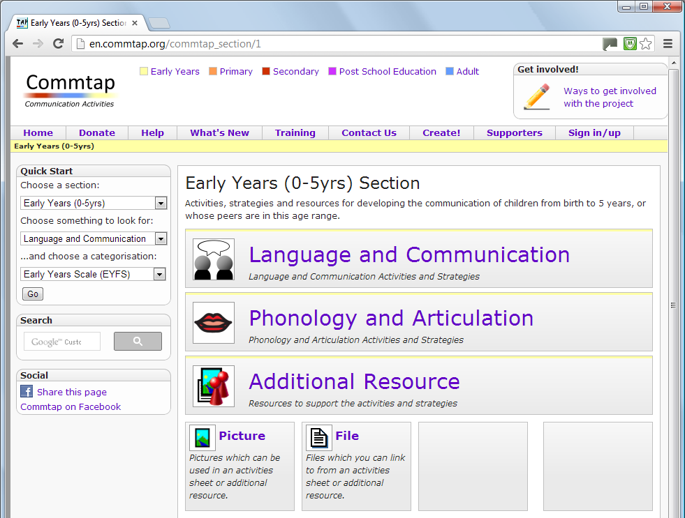
Notes:
Mention additional resources and what they are.

Slide 17
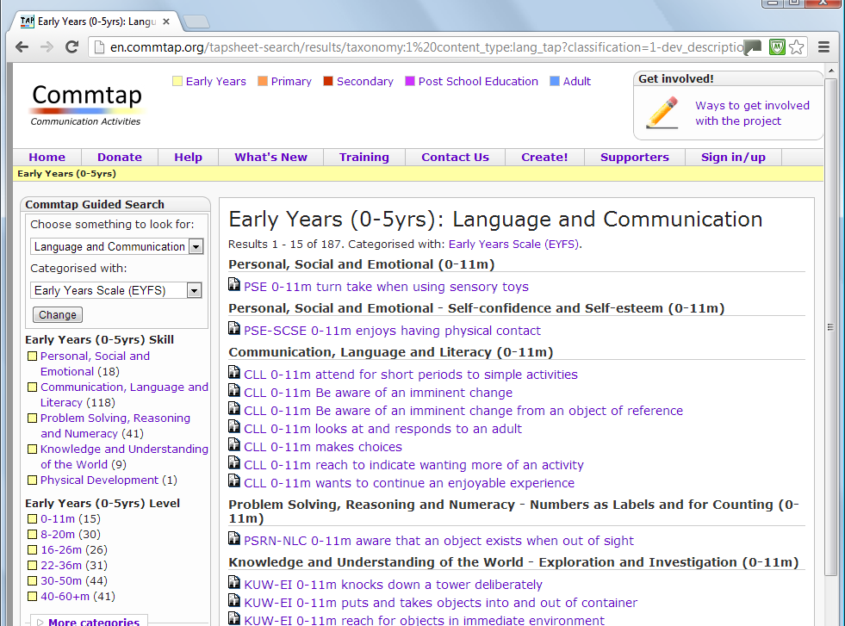
Notes:
You can narrow down to a skill area or level on the left. Note maths includes a lot of language concepts – e.g. prepositions. If you click on “more categories” you will be able to narrow down the list to different types of disability – e.g. ASD. We’ll click on “P4-P8”. We use core curriculum areas to categorise the communication activities sheets.

Slide 18
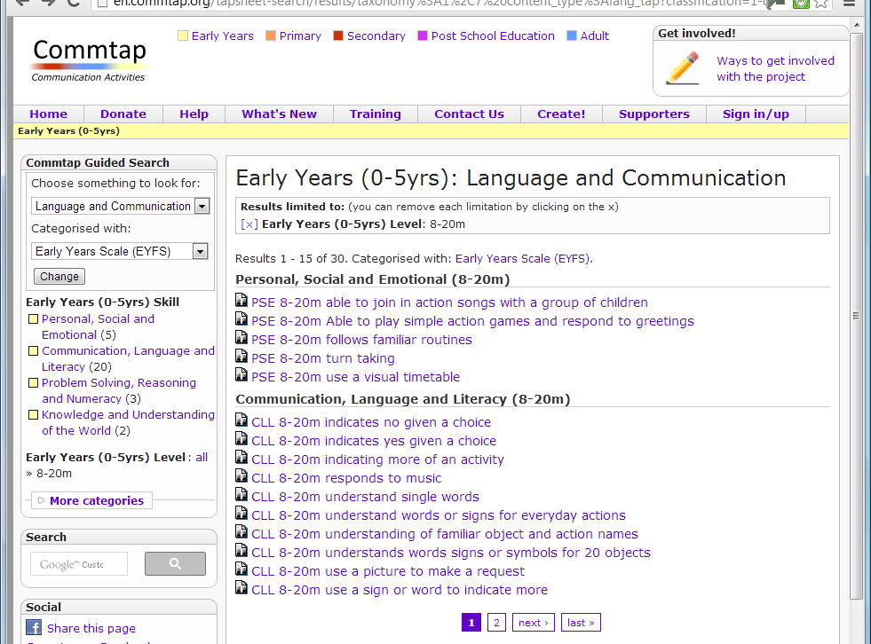

Slide 19
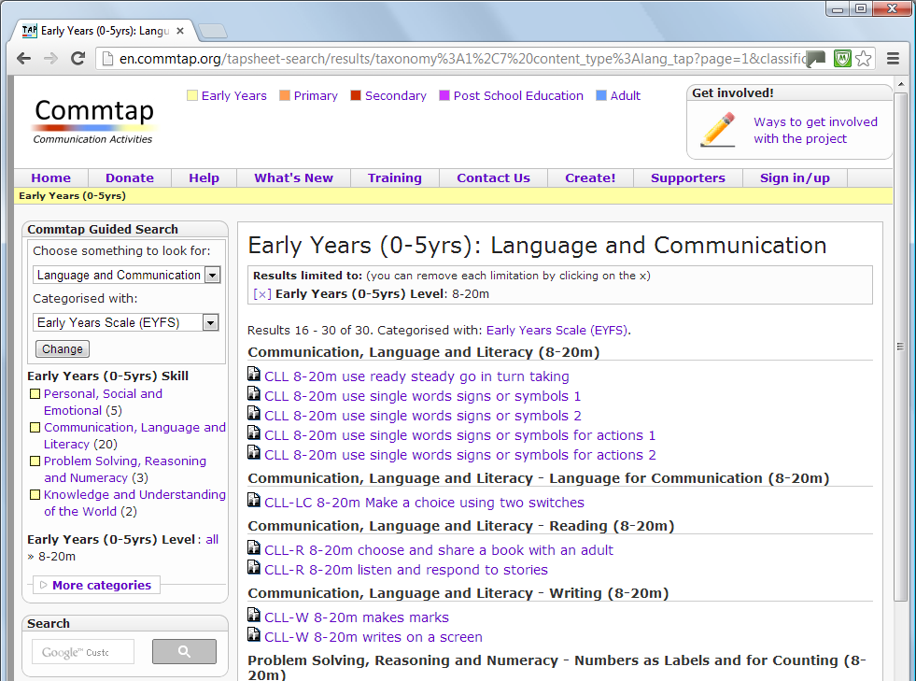

Slide 20
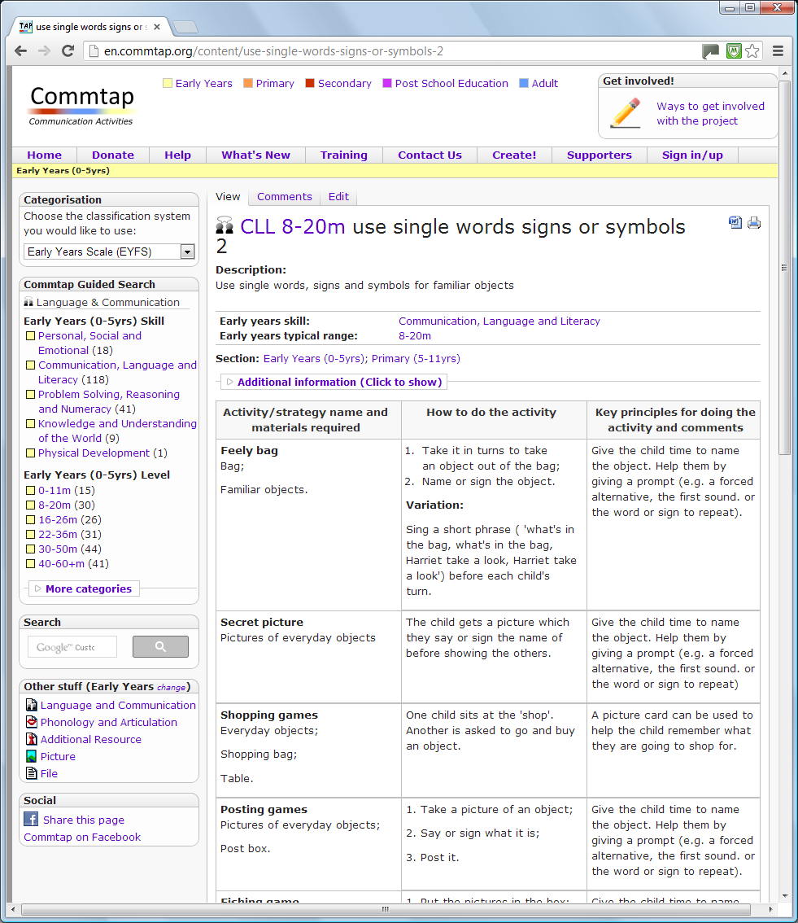
Notes:
Note standard format

Slide 21
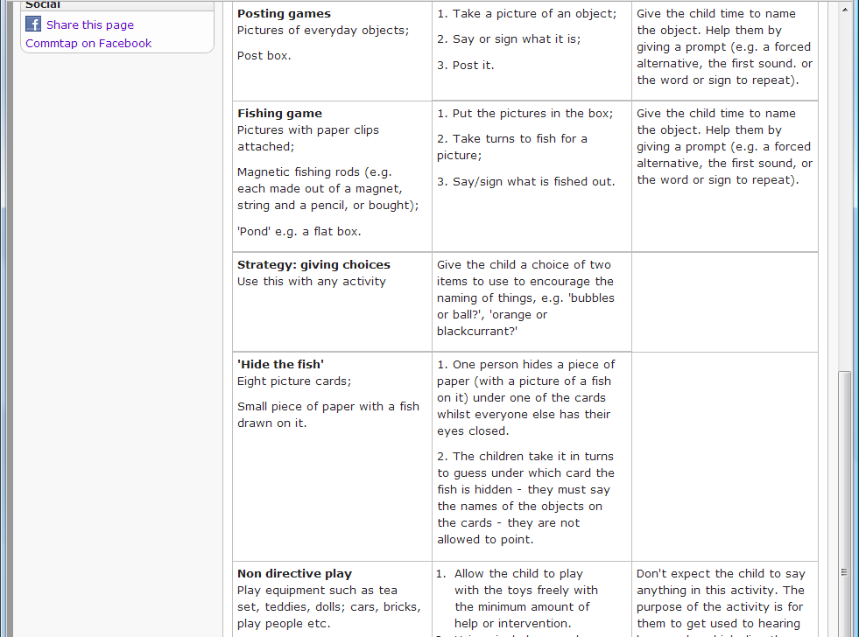

Slide 22
Notes:
This is classified with English Writing P8. Click on any of the links to find out more about the description – let’s click on “EW P8” to find more about that. Emphasise that everything on the site comes from SLTs – like yourselves – if it is lacking in some areas – then add something!!

Slide 23
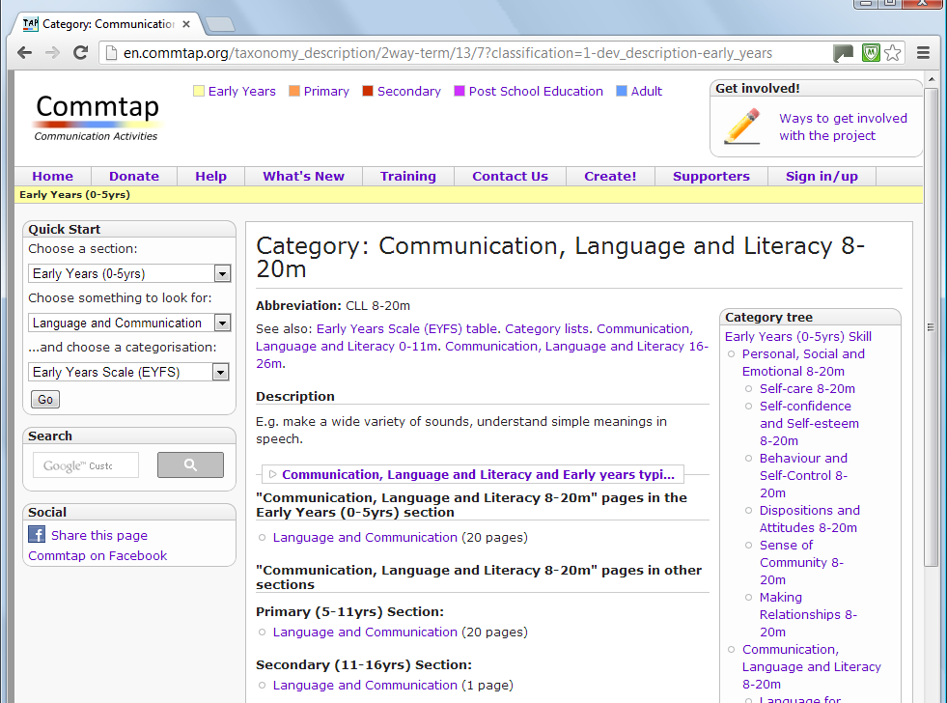
Notes:
This page gives a description of what CLl 8-20m means, and has links to other material on the site categorised with the same skill/level. You will notice that there are also links at the top – to a table summarising the EYFS curriculum, a list of categories, things at the next highest and lowest skill levels. Click on the links on the right hand side under – e.g. Language for Communication – there is a longer description which comes from the EYFS published curriculum.

Slide 24
Notes:
We are in the Primary Section, but notice that this activities sheet has also been categorised as being suitable for Early Years.

Slide 25
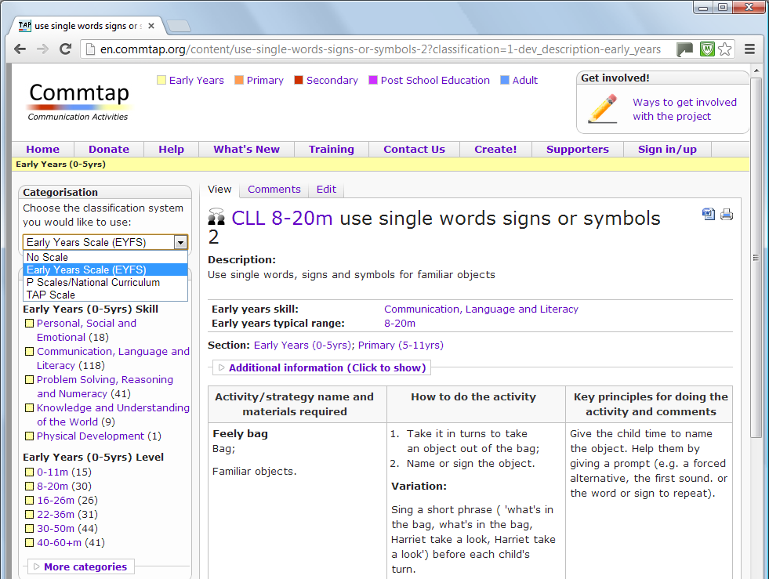

Slide 26
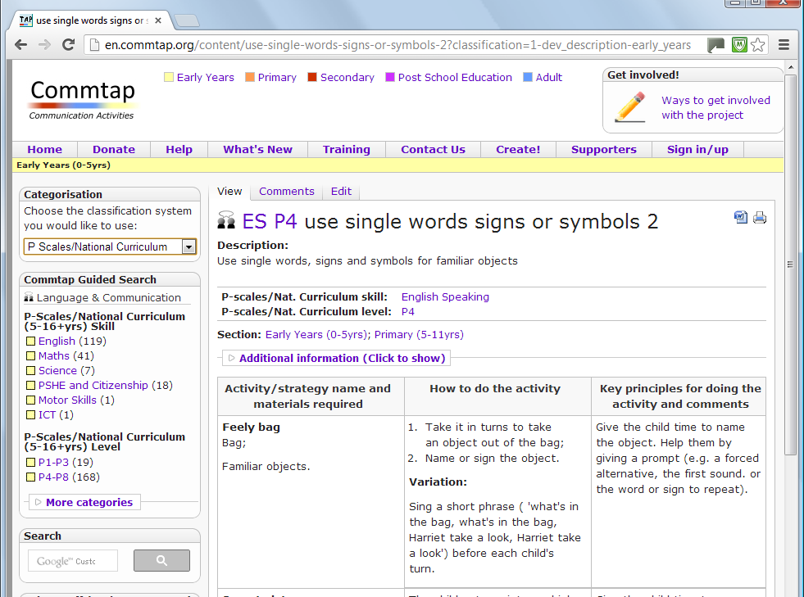
Notes:
Similarly you can click on the skill/level code to find out what that means.

Slide 27
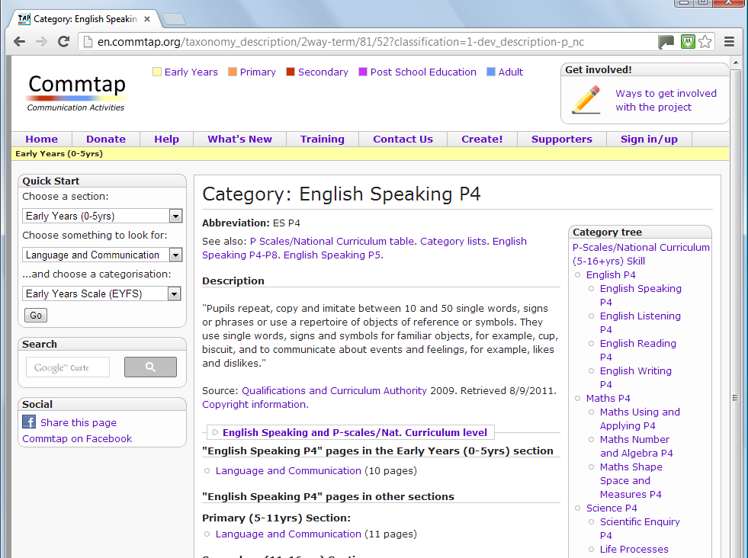

Slide 28
Notes:
You can download the page as a Word document, you can also get a “printer friendly” version of the page (though any way of printing will produce a printer friendly page).

Slide 29
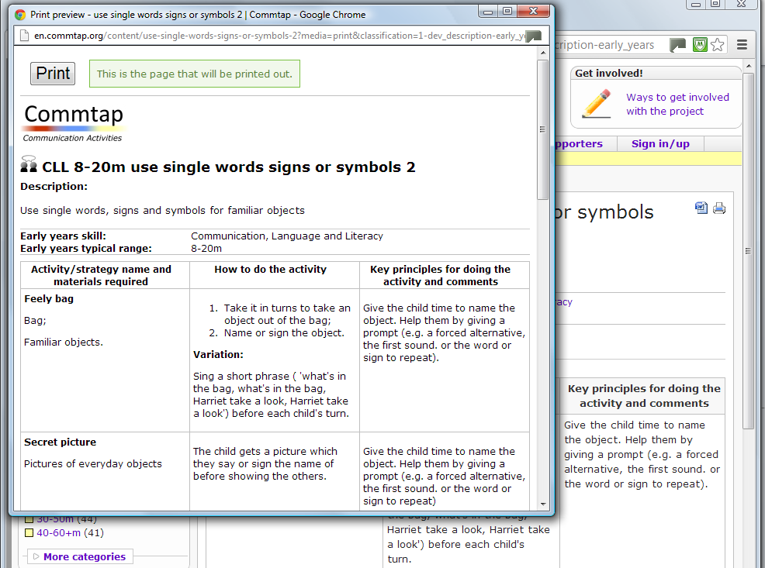

Slide 30
Notes:
Not sure about what the P-Scales (or early years foundation stage curriculum etc. means?) then click through on this link.

Slide 31
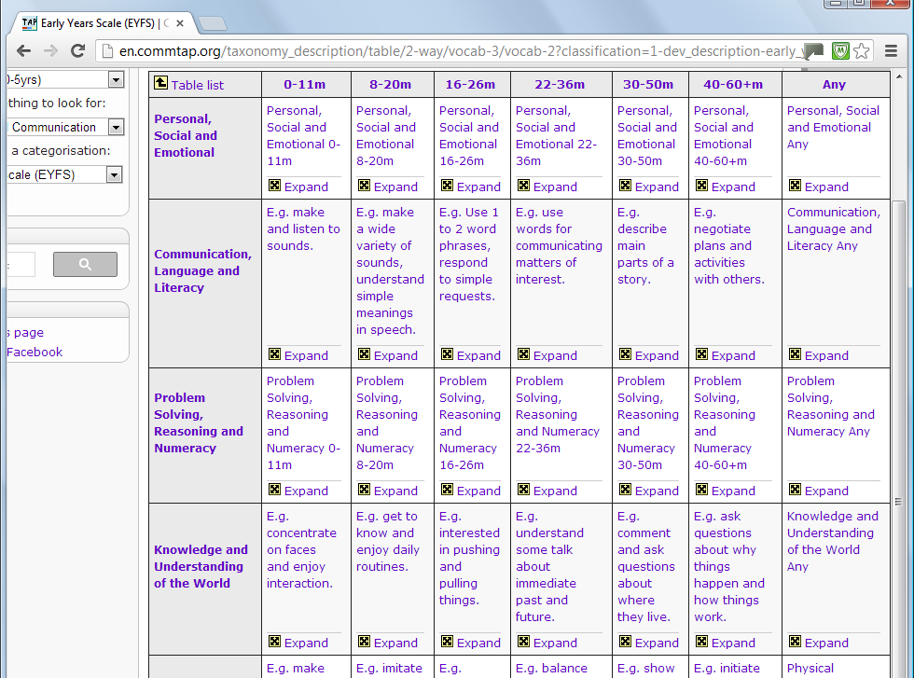
Notes:
Click on “expand” to go in more detail. Spend a little bit of time explaining what the P-Scales are and how we can use them in SLT: point out where you might find different SLT targets. Don’t assume SLTs know the P-Scales – or the EYFS curriculum for that matter – they probably won’t!

Slide 32
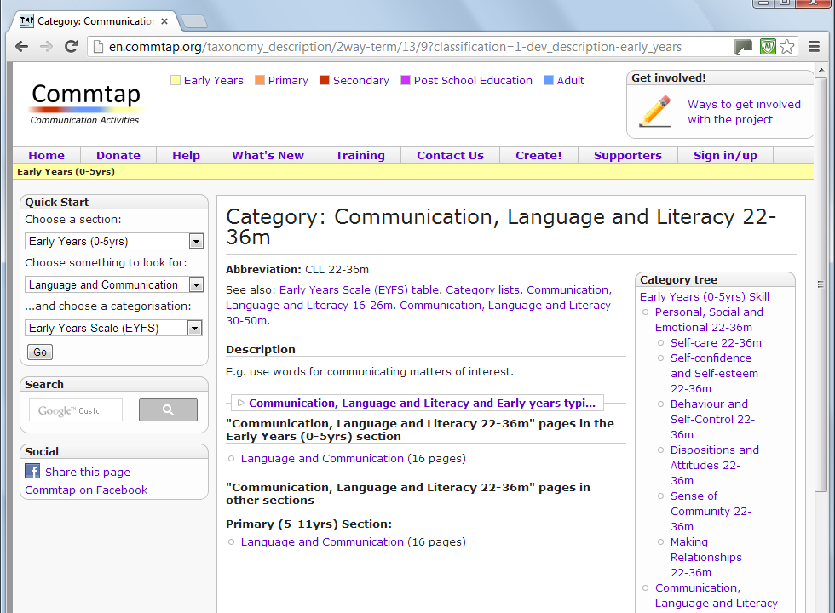

Slide 33
Commtap Core Philosophy…

Slide 34
Before the internet
One or two people write a book
Everyone else reads it
If you are lucky – the author accepts feedback about the book and a few years later updates it
Notes:
One or two active suppliers of information
Everyone else is a passive recipient of this information
This centralisation of information has developed particularly through development of printed media/television/radio etc…

Slide 35
With the internet
Lots of people write the material
Lots more people read it
Direct feedback – comments and rewriting
The material is updated (over a matter of days with edits and checks)
Quality and quantity expands
rapidly
Notes:
Everyone can be a recipient of the information and can be active in improving and developing that information

Slide 36
The Commtap site
Dynamic and constantly evolving
Doesn’t go out of date the minute it is published (unlike books, CD-ROMs, video, etc.)

Slide 37

How Commtap constantly develops
Moderators check/
edit the sheet
Edit an activities
sheet
Create a new
activities sheet
Notes:
This is how it works
There is constant interaction between users and the site
The same applies for additional resources

Slide 38
How Commtap develops
There are now over 500 activities sheets and other resources on this site contributed using this method
These incorporate over 1500 activities
Around 6,000 visitors and 30,000 page views per month

Slide 39
Contributing to the site
Notes:
Adding activities sheets to the site.
For this site to be of maximum benefit to SLTs, Schools and the children we work with it is essential that as many of those who can do add activities on to the site

Slide 40
Contributing activities to the site
Uploading is easy
Editing sheets is easy
It’s anonymous, or you can choose to be acknowledged on the site as a contributor
Notes:
If you have ideas for new sheets or to change existing ones – contribute!!! Don’t mention the advanced way of adding stuff to the site! (It will be pretty daunting for a lot of people).

Slide 41
Contributing to the site
Follow the step by step instructions on the site to:
Create a new activities sheet
Edit something that is on the site
Upload it to the site
Notes:
Manually step through this on the actual site.

Slide 42
Quality control
Nothing is publicly visible before it has been checked
Everything added to the site is checked for its content
The name is modified if necessary
Documents which pass the checks will appear in the appropriate part of the site

Slide 43
Copyright
Anyone can download and copy the documents on the site
It is OK for anyone to republish the material if they so wish (so long as Commtap is acknowledged in the re-publication)
Notes:
We use a “Creative Commons” license for most of the written material – you can re-use the material for commercial or non-commercial use – all you need to ensure is that you indicate that it came from www.commtap.org.
The principle is freedom of access – there is detailed information about this on the site.
The material on the site will have been produced by lots of different people.
It is important that those who have contributed material to the site can still use this in whatever way they wish.
This is notably different from say submission to a magazine

Slide 44
Consultative model
Commtap means
  A shared framework to look at a child’s needs
  Speech, language and communication targets are more readily understandable
  The area of learning supported by a target is clearer – easier to include in class planning
  A wider range of clearer activities
  Empowering a child’s teaching teams.

Slide 45
Summary of site benefits
Resource base – much bigger and better than any one department could produce
Exploits the power of the internet
Integrated approach
Time management
Improving quality of what we all do

Slide 46
CommunicationTargets and Activities Project
www.commtap.org

