Slide 1
Using Commtap Communication Targets and Activities Project

Slide 2
Summary
Typical SLT process
Purpose of Commtap
How the Commtap site is organised
Commtap philosophy
Adding stuff to the site
Summary
Notes:
Use it or loose it
It’s as good as you make it
Growth through collaboration

Slide 3
Typical specialist input for communication
Do some assessment
Carry out some kind of intervention
Train others to carry out this intervention
Provide or recommend activities for others to continue with
Try to integrate this work into what else is happening for the children
Notes:
Assessment should be based on the needs of the child in terms of the impact the child’s communication may be having on the quality of their life. It should be around the hypotheses you make and develop around this. There should be some link with what you assess and what the child’s day to day difficulties are – i.e. don’t just do an entire CELF for example: this is like going on a fishing exhibition – if you do a lot of assessment you will always find something wrong, some kind of relative deficit, but the existence of a deficit itself is no evidence that it is having any impact on the client – it must be possible to show a clear logical connection (based on your thinking, research evidence and experience). If you work on deficits that you happen to find without any thinking about how that links to functional disability (and that to quality of life impact), then there is a high risk that the child’s problem won’t be addressed – or that it will only be addressed by luck – neither of these are good news for the SLT evidence base or indeed justifying SLT at all.
An e.g. some unspecified problem -> do CELF, discover not good at following directions -> set a narrative target and suggest ELKLAN type intervention. What happened: did the assessment (weren’t sure why), didn’t like the result, so suggested something else. The something else may be useful, but the thinking was a bit disjointed.

Slide 4
Typical targeted input for communication
Identified group of children
Carry out some kind of work to develop communication
Train others to carry out this work
Provide or recommend activities for others to continue with

Slide 5
Problems
Providing programmes and ideas
Can be either too much:
Or too little…
Notes:
Schools often have no way of regulating the amount of stuff they get
A successful school run language group requires (amongst other things) an adequate supply of easy to use activities
Therapists may not visit schools very often, and may compensate by providing a lot of stuff all at once

Slide 6
Problems…
Variety of formats
Not clearly linked to other work going on in school
Lots of rewriting of the same old stuff or…
Use of whatever was in the filing cabinet which seemed vaguely appropriate – hopefully now supplemented with lot better resources from the internet or your computer

Slide 7
The idea behind Commtap
Avoid duplication of effort
Have activities based on actual communication targets or goals
Have them organised logically so they can easily be found
Use education as well as SLT language
Easy access for all

Slide 8
The Commtap website
Designed to be simple, quick and easy to use
Easy for SLTs and others to add to it
Creates a community to share activities:
For schools to use the site to support advice from specialists
For SLTs and other specialists to be actively involved in developing the activities on the site
All activities and resources added to the site are checked/edited before being made publicly viewable

Slide 9
How stuff is organised
To organise activities and other resources on the site, Commtap uses:
The Early Years Foundation Stage Curriculum
The P-Scales
The National Curriculum
A “TAP” (Targets and Activities Project) Scale (for good luck!)

Slide 10
Fitting stuff into the scales
Just about any language or social skills target can be fitted into these scales
To get these levels right, we use:
The Department for Education’s descriptions of these scales;
Published assessment tools – particularly B-Squared;
Published research.
Notes:
B-Squared gives more detailed information about what might be expected at each level.

Slide 11
Phonology and Articulation
Speech phonology and articulation does not fit well into these scales
Targets and activities for this is organised around different types of speech skills

Slide 12
The Commtap Site
Finding activities sheets
TAP core philosophy
Contributing to the site
Quality control

Slide 13
Finding activities sheets

Slide 14
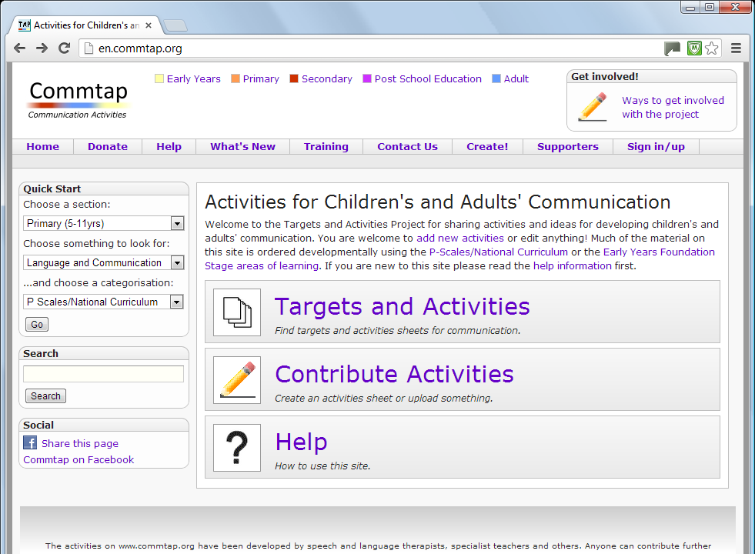
Notes:
You can find activities sheets in various ways. We’ll choose “Targets and Activities” as this will show you more how the site is structured.

Slide 15
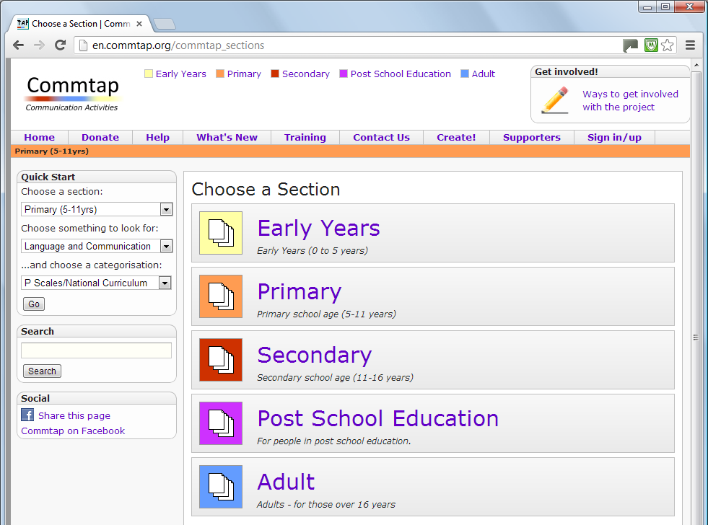

Slide 16
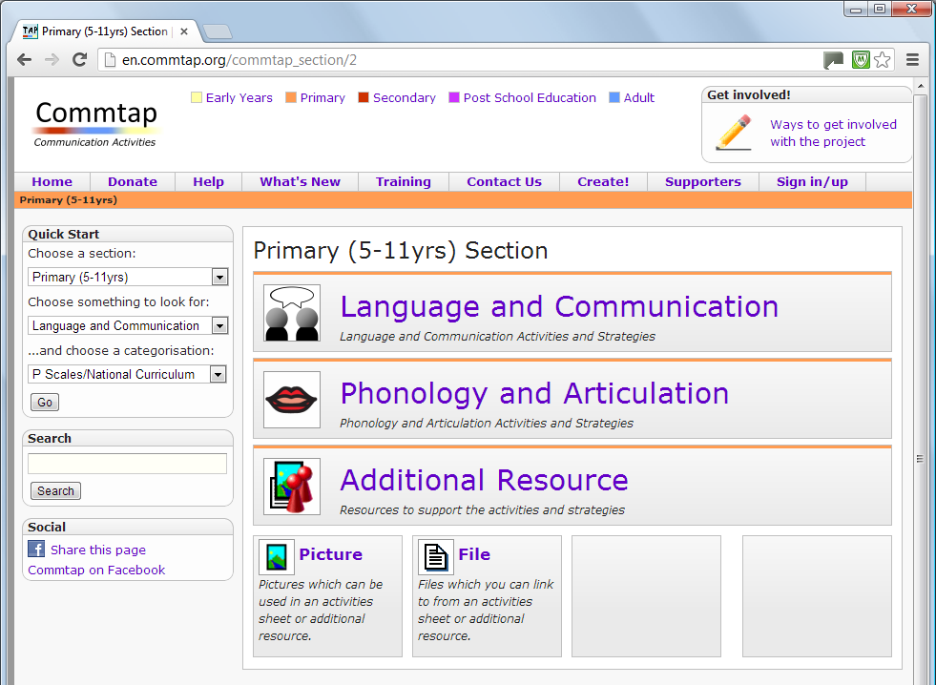
Notes:
Mention additional resources and what they are.

Slide 17
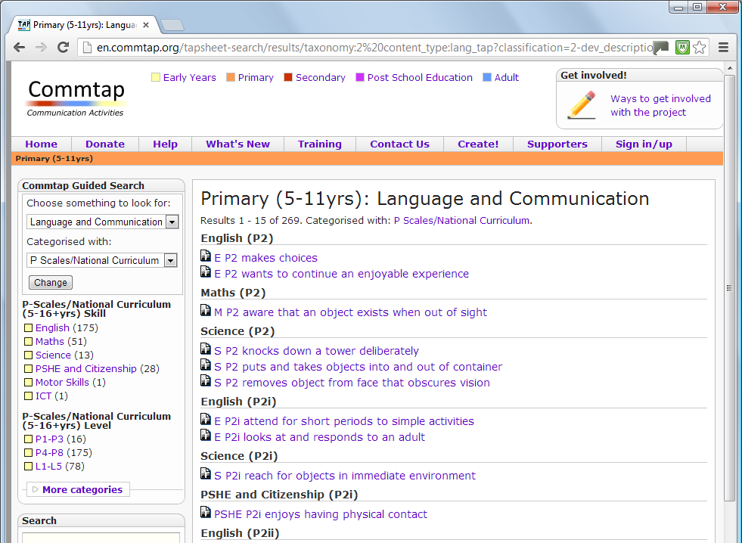
Notes:
You can narrow down to a skill area or level on the left. Note maths includes a lot of language concepts – e.g. prepositions. If you click on “more categories” you will be able to narrow down the list to different types of disability – e.g. ASD. We’ll click on “P4-P8”. We use core curriculum areas to categorise the communication activities sheets.

Slide 18
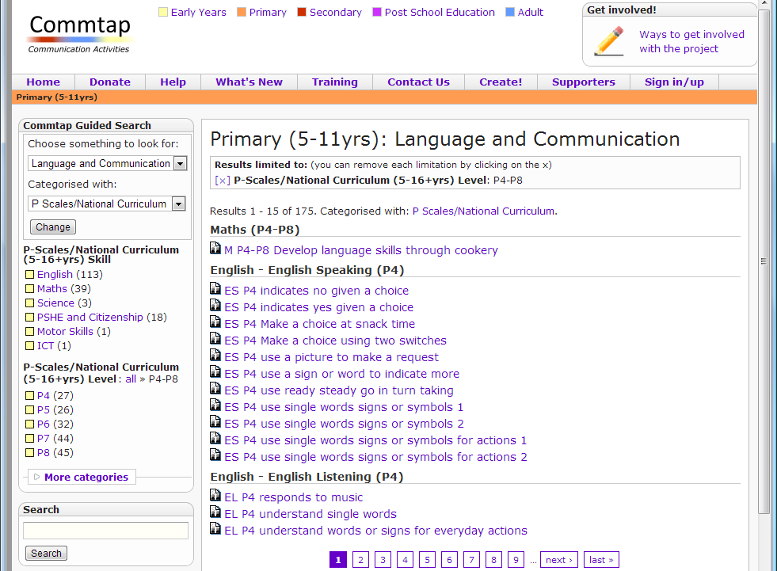
Notes:
Everything is arranged in approximately developmental order (i.e. with P-Scales etc.)

Slide 19
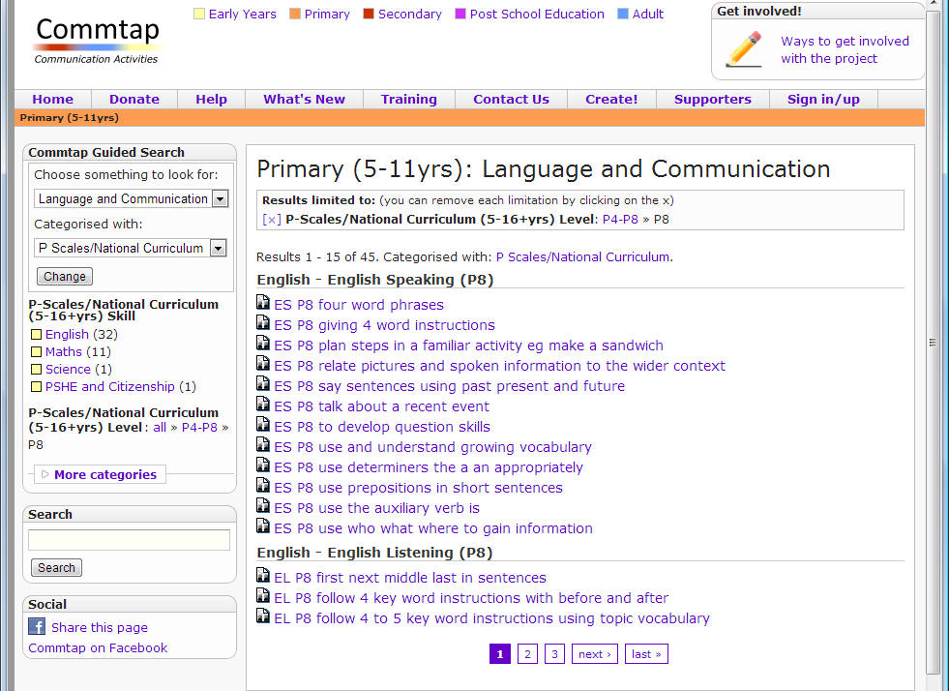

Slide 20
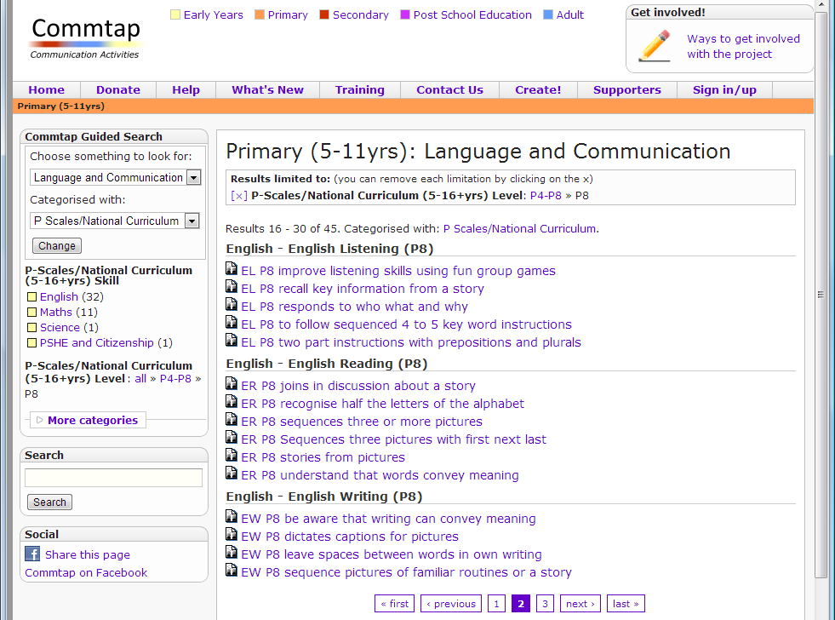

Slide 21
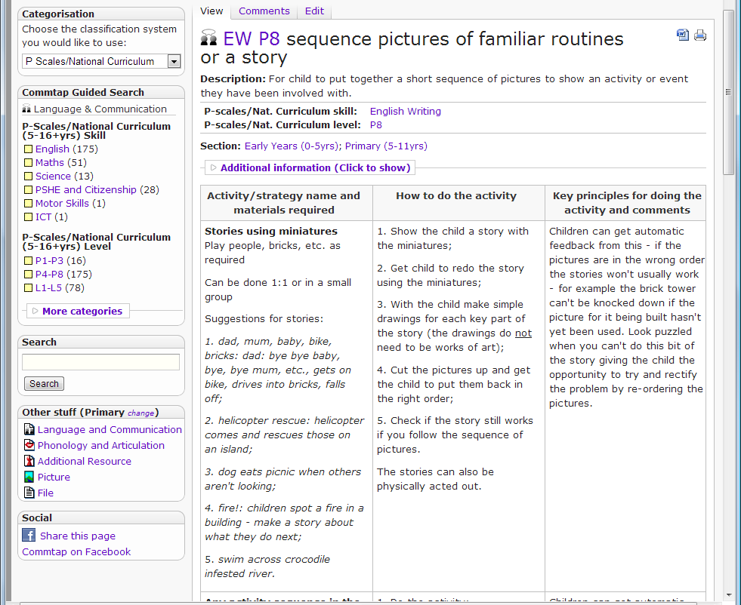
Notes:
Note standard format

Slide 22
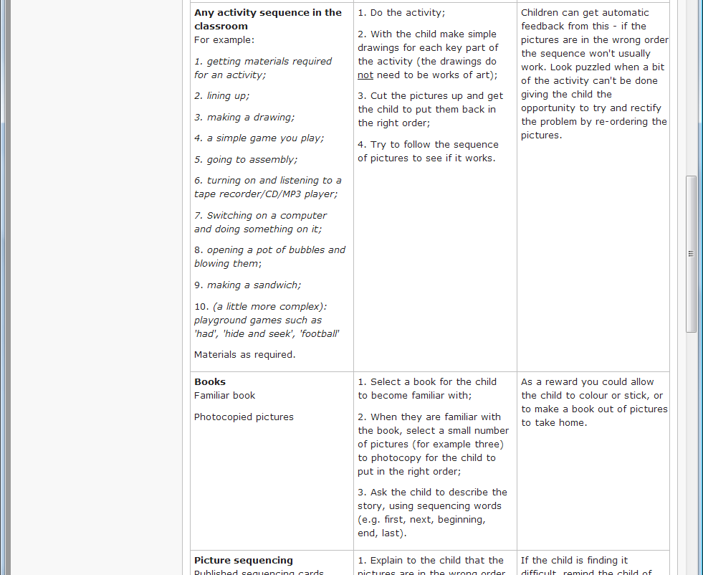

Slide 23
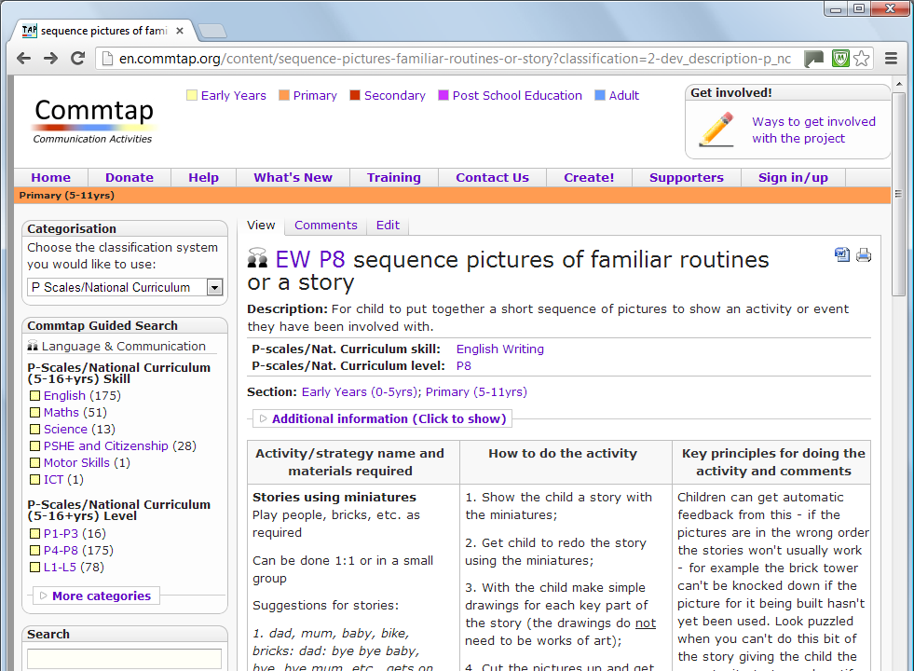
Notes:
This is classified with English Writing P8. Click on any of the links to find out more about the description – let’s click on “EW P8” to find more about that. Emphasise that everything on the site comes from SLTs – like yourselves – if it is lacking in some areas – then add something!!

Slide 24
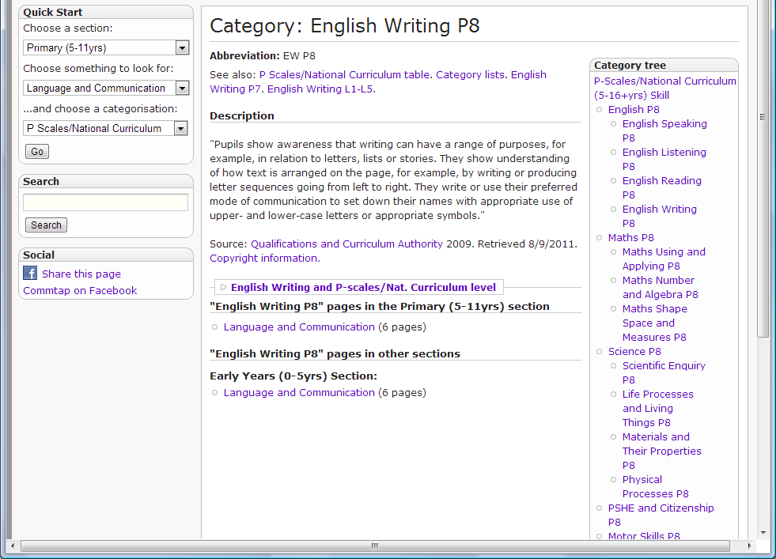
Notes:
This page gives a description of what EW P8 means, and has links to other material on the site categorised with the same skill/level. You will notice that there are also links at the top – to a table showing a list of P-levels, a list of categories, things at the next highest and lowest skill levels.

Slide 25
Notes:
We are in the Primary Section, but notice that this activities sheet has also been categorised as being suitable for Early Years.

Slide 26
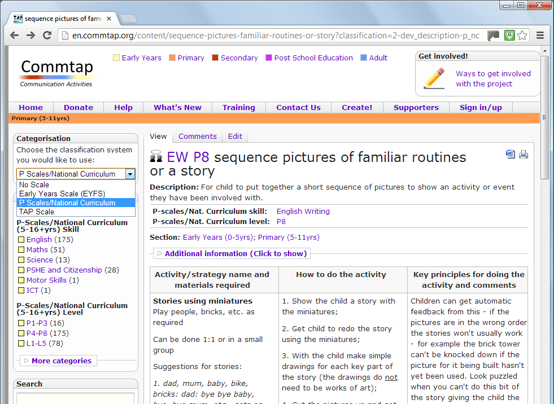

Slide 27
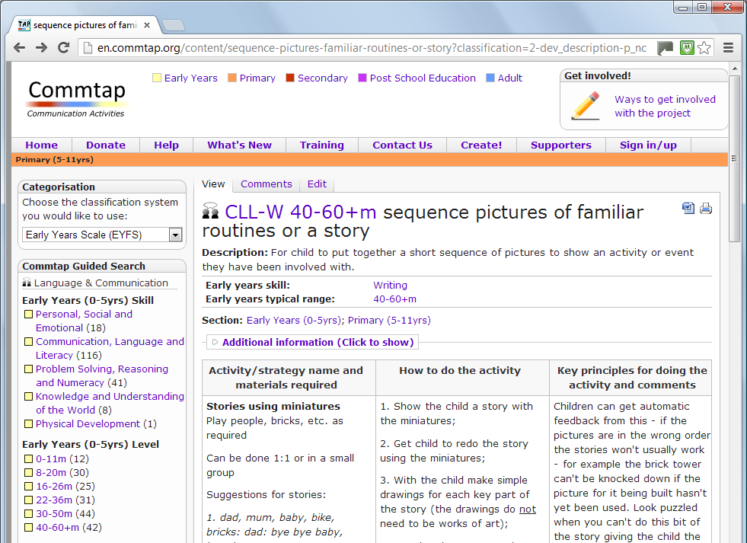
Notes:
Similarly you can click on the skill/level code to find out what that means.

Slide 28
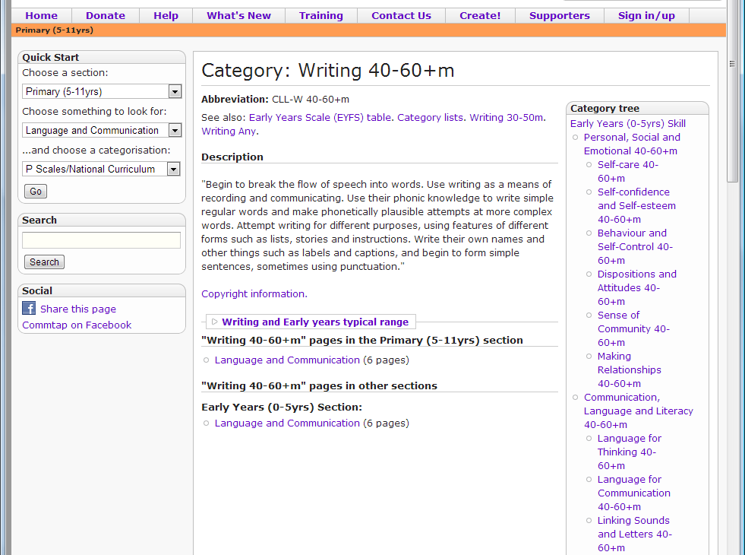

Slide 29
Notes:
You can download the page as a Word document, you can also get a “printer friendly” version of the page (though any way of printing will produce a printer friendly page).

Slide 31
Notes:
Not sure about what the P-Scales (or early years foundation stage curriculum etc. means?) then click through on this link.

Slide 32
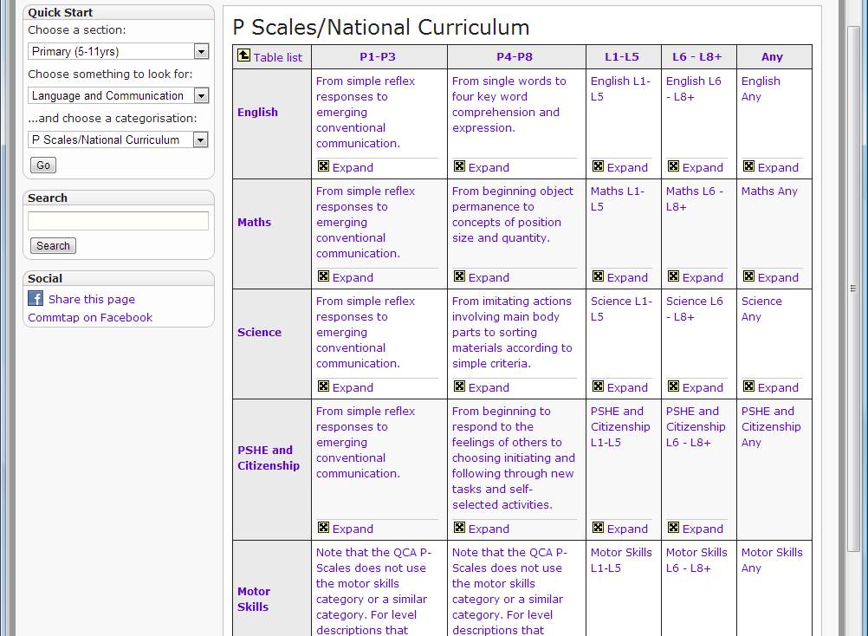
Notes:
Click on “expand” to go in more detail. Spend a little bit of time explaining what the P-Scales are and how we can use them in SLT: point out where you might find different SLT targets. Don’t assume SLTs know the P-Scales – or the EYFS curriculum for that matter – they probably won’t!

Slide 33
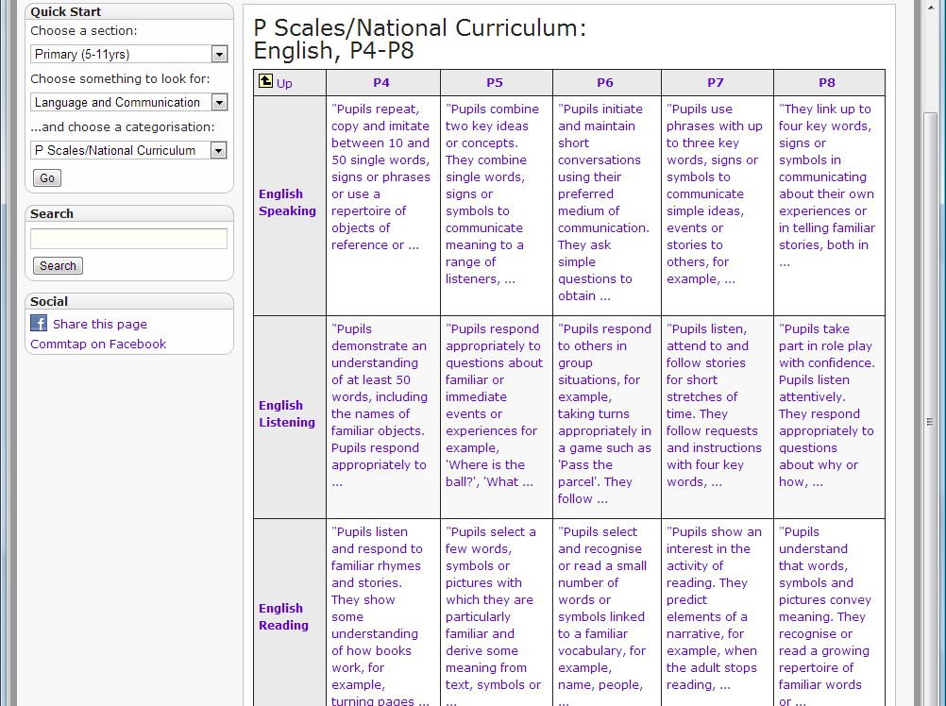
Notes:
Click on the text in the box to go to page with a longer description (where available), and links to activities sheets at that level.

Slide 34
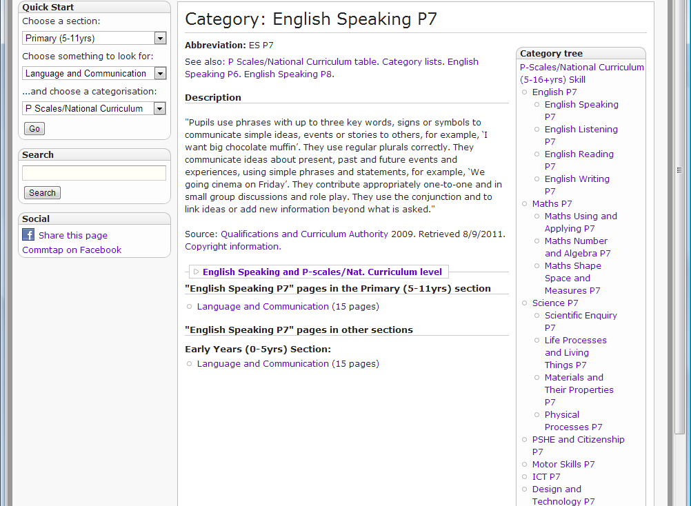

Slide 35
Commtap Core Philosophy…

Slide 36
Before the internet
One or two people write a book
Everyone else reads it
If you are lucky – the author accepts feedback about the book and a few years later updates it
Notes:
One or two active suppliers of information
Everyone else is a passive recipient of this information
This centralisation of information has developed particularly through development of printed media/television/radio etc…

Slide 37
With the internet
Lots of people write the material
Lots more people read it
Direct feedback – comments and rewriting
The material is updated (over a matter of days with edits and checks)
Quality and quantity expands
rapidly
Notes:
Everyone can be a recipient of the information and can be active in improving and developing that information

Slide 38
The Commtap site
Dynamic and constantly evolving
Doesn’t go out of date the minute it is published (unlike books, CD-ROMs, video, etc.)

Slide 39
How Commtap constantly develops
Moderators check/
edit the sheet
Edit an activities
sheet
Create a new
activities sheet
Notes:
This is how it works
There is constant interaction between users and the site
The same applies for additional resources

Slide 40
How Commtap develops
There are now over 500 activities sheets and other resources on this site contributed using this method
These incorporate over 1500 activities
Around 6,000 visitors and 30,000 page views per month

Slide 41
Contributing to the site
Notes:
Adding activities sheets to the site.
For this site to be of maximum benefit to SLTs, Schools and the children we work with it is essential that as many of those who can do add activities on to the site

Slide 42
Contributing activities to the site
Uploading is easy
Editing sheets is easy
It’s anonymous, or you can choose to be acknowledged on the site as a contributor
Notes:
If you have ideas for new sheets or to change existing ones – contribute!!! Don’t mention the advanced way of adding stuff to the site! (It will be pretty daunting for a lot of people).

Slide 43
Contributing to the site
Follow the step by step instructions on the site to:
Create a new activities sheet
Edit something that is on the site
Upload it to the site
Notes:
Manually step through this on the actual site.

Slide 44
Quality control
Nothing is publicly visible before it has been checked
Everything added to the site is checked for its content
The name is modified if necessary
Documents which pass the checks will appear in the appropriate part of the site

Slide 45
Contributing activities – ideas
The site is designed to save you time so that you need to write activities less often – but you will still need to write them from time to time.

Slide 46
Contributing activities - ideas
You don’t need to be satisfied with activities that almost fit
You can create new activities;
You can modify activities to work with different children (e.g. older, with a specific disability) and add that to the site as a new activities sheet;
You can modify activities for specific topics/lessons – e.g. where the class topic is “The Victorians” – what materials might be available say for a child working on narrative.

Slide 47
Copyright
Anyone can download and copy the documents on the site
It is OK for anyone to republish the material if they so wish (so long as Commtap is acknowledged in the re-publication)
Notes:
We use a “Creative Commons” license for most of the written material – you can re-use the material for commercial or non-commercial use – all you need to ensure is that you indicate that it came from www.commtap.org.
The principle is freedom of access – there is detailed information about this on the site.
The material on the site will have been produced by lots of different people.
It is important that those who have contributed material to the site can still use this in whatever way they wish.
This is notably different from say submission to a magazine

Slide 48
Consultative model
Commtap means
A shared framework to look at a child’s needs
Speech, language and communication targets are more readily understandable
The area of learning supported by a target is clearer – easier to include in class planning
A wider range of clearer activities
Empowering a child’s teaching teams.

Slide 49
Summary of site benefits
Resource base – much bigger and better than any one department could produce
Exploits the power of the internet
Integrated approach
Time management
Improving quality of what we all do

Slide 50
CommunicationTargets and Activities Project
www.commtap.org

